Slide 1





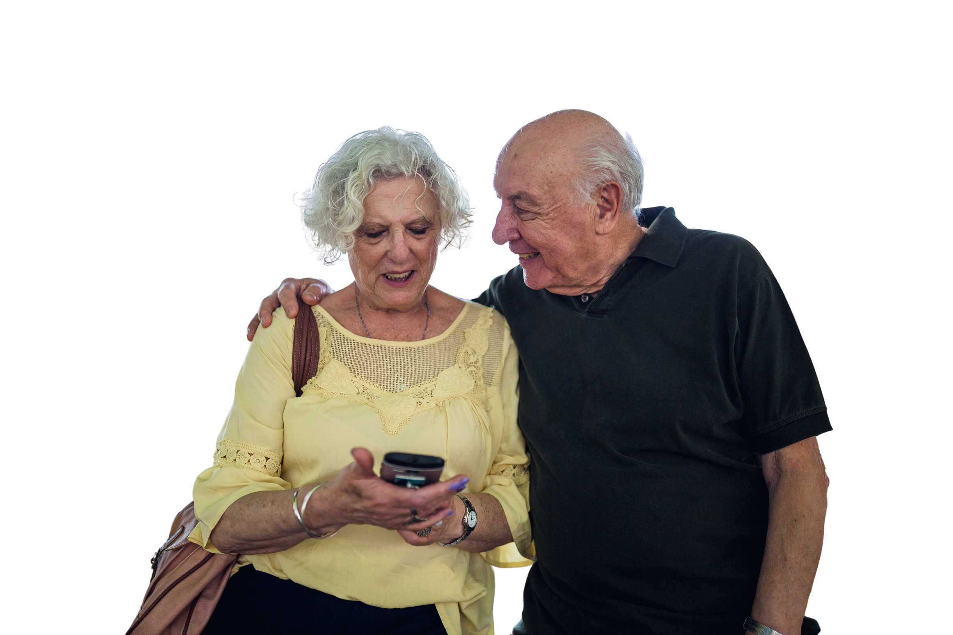








Morning tech and search
Add your logo here

Slide 2


Acknowledgement of Country
We acknowledge the traditional custodians of the land and pay our respect to Elders past and present and extend that respect to Aboriginal and Torres Strait Islander peoples joining us today.
Image credit: Urtakerte/Heart indigemoji
Artist: Dreamtime Ladie by Kathleen Kemarre Wallace with Graham Wilfred
Download Indigenous emojis at www.indigemoji.com.au

Slide 3


Icebreaker!
  Introduce yourself
  Share one thing you are excited to learn today

Slide 4
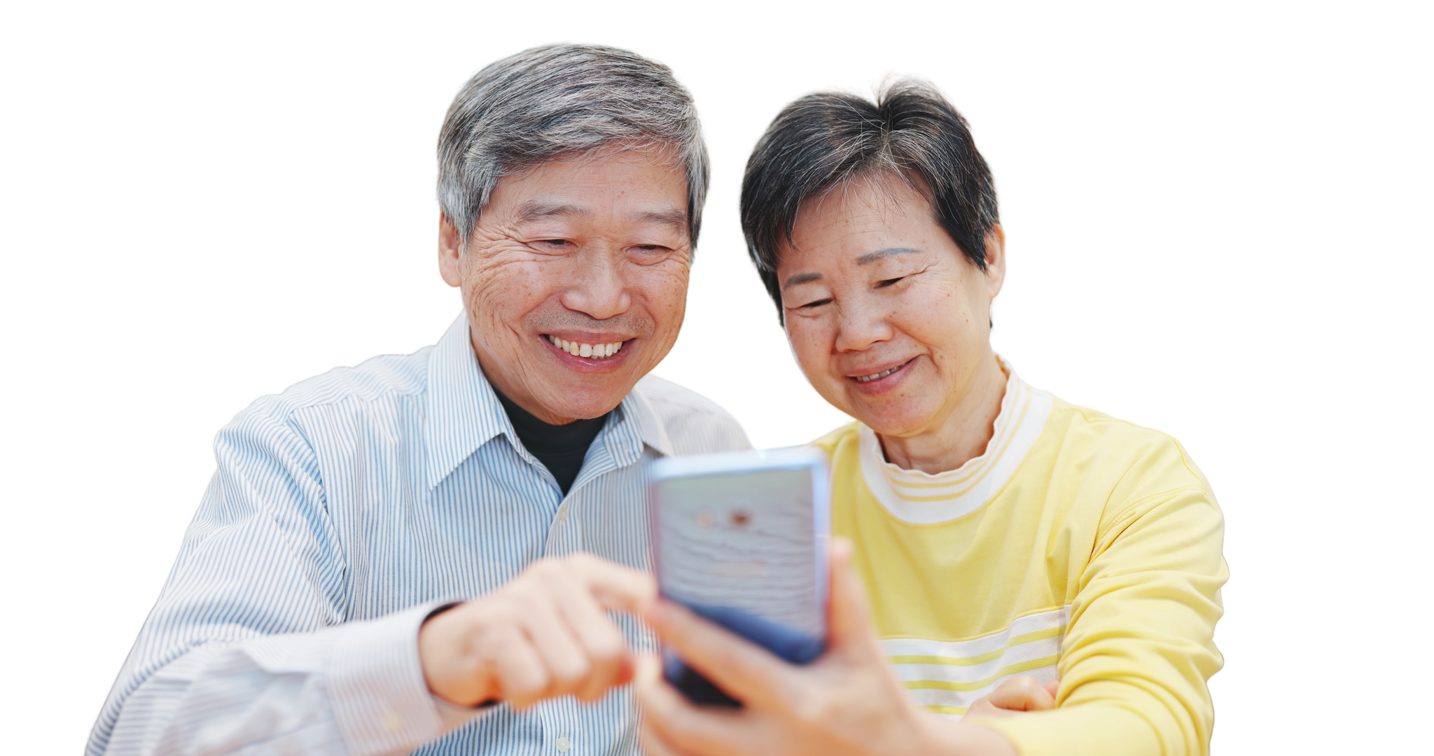
Happy
Get Online Week!
This event is part of a nation wide campaign to support people to feel safer and more confident online

Slide 5
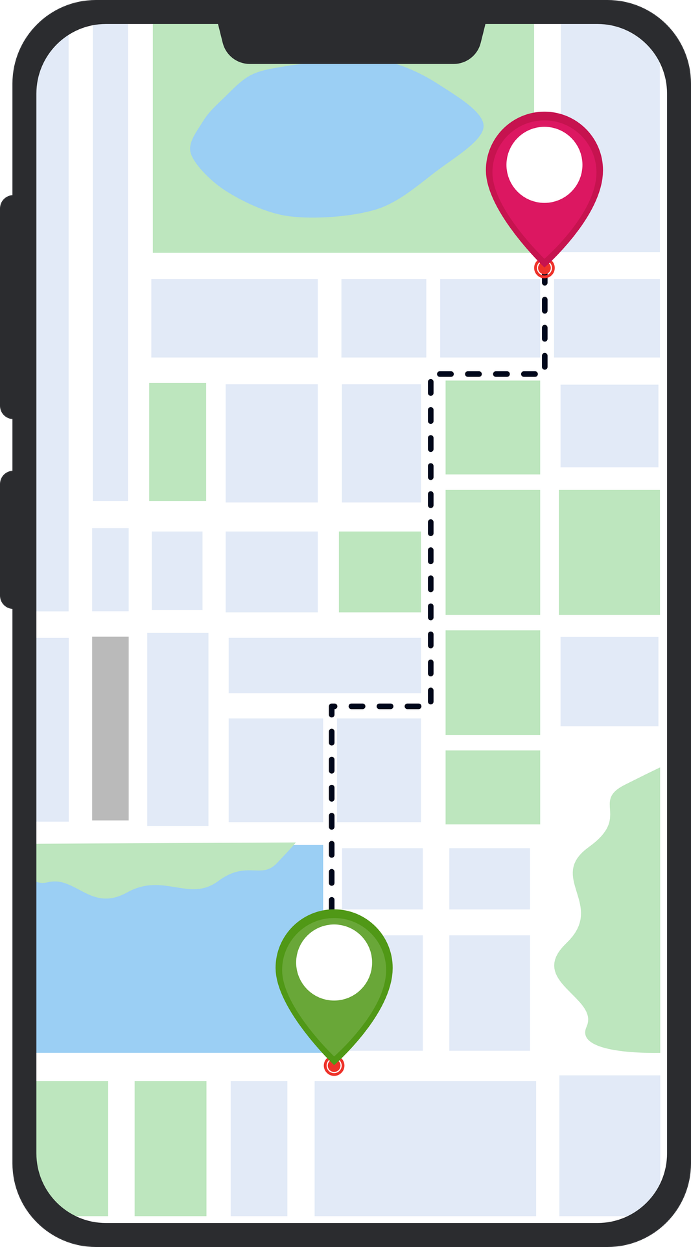
Google/Apple Maps
  Have you used a maps app before?
  What do you know about Google Maps or Apple Maps?

Slide 6

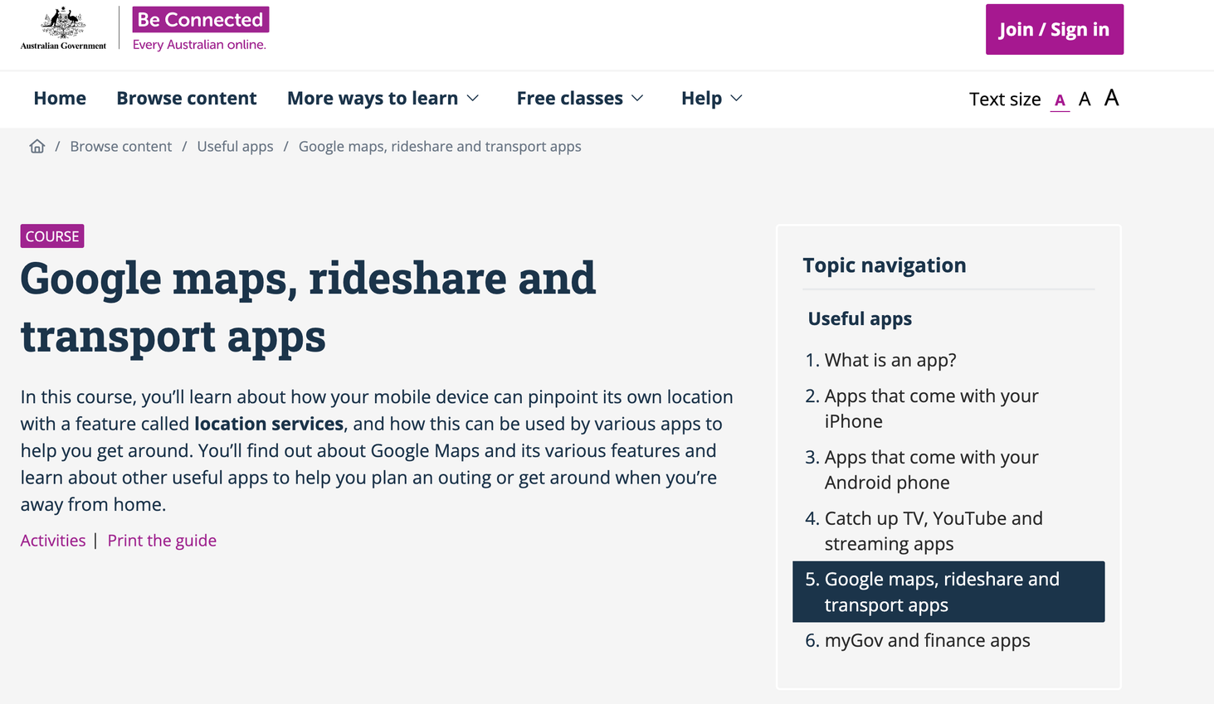
Learning how to use Google/Apple maps
Visit Be Connected to learn more about map apps
Be Connected Google maps course

Slide 7


Go to Google/Apple maps!

Slide 8

Your turn: Cafe search
  Go to Google/Apple maps
  Search for cafes in your area
  Find the cafe with the highest rating
  Bonus round: Find the fastest route to get there

Slide 9

Safety tip: Check the information you found. Did it seem right to you? Do you agree with the reviews?

Slide 10

Questions?
Share one thing that you have learnt today!

Slide 11
Our next session
Topic:
Time:
Date:

Slide 12
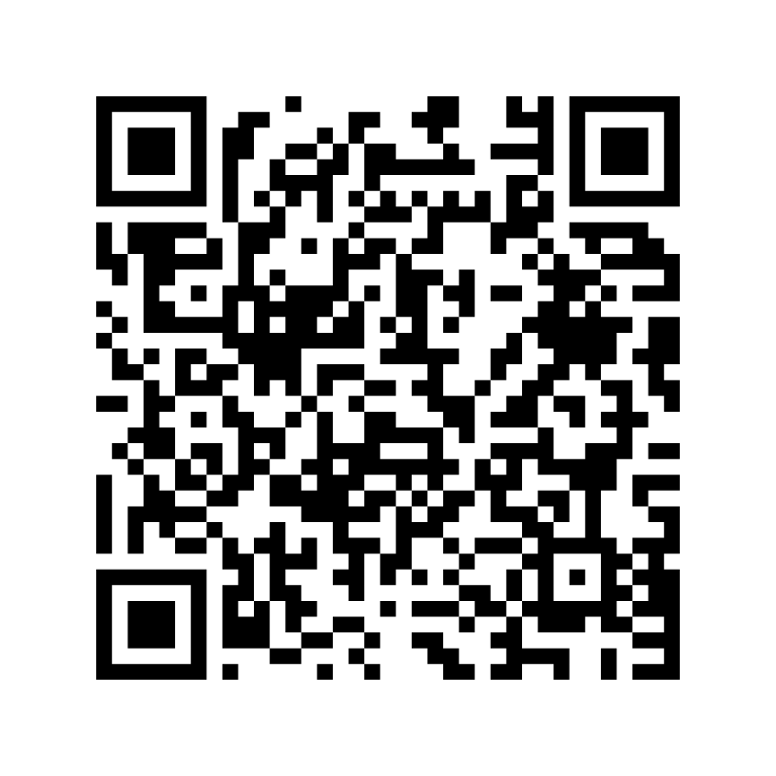
Share your feedback
  Help Good Things know the impact of Get Online Week
  Scan the QR code or go to this website
my.goodthingsaustralia.org/s/gow-event-survey

Slide 13



Learn more good things
www.goodthingsaustralia.org
beconnected.esafety.gov.au

