Slide 1











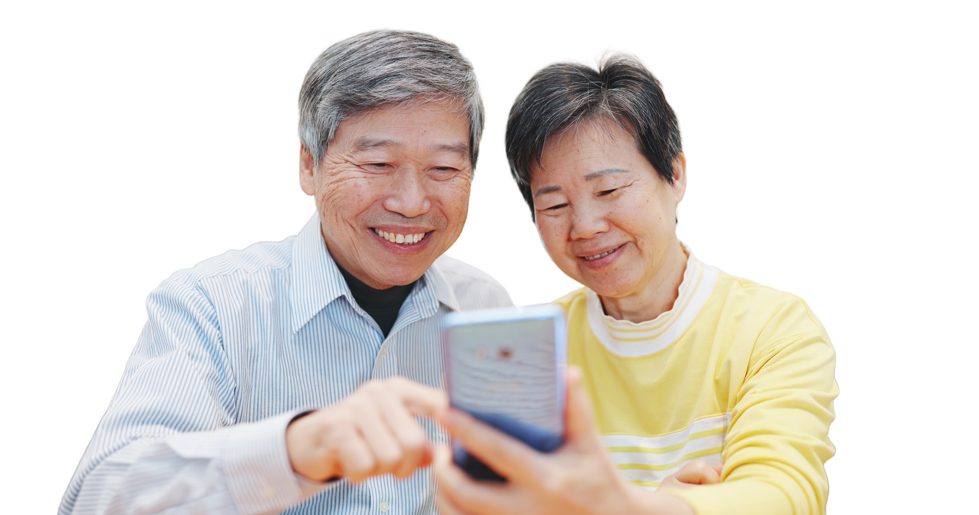



YouTube Karaoke
Add your logo here

Slide 2


Acknowledgement of Country
We acknowledge the traditional custodians of the land and pay our respect to Elders past and present and extend that respect to Aboriginal and Torres Strait Islander peoples joining us today.
Image credit: Urtakerte/Heart indigemoji
Artist: Dreamtime Ladie by Kathleen Kemarre Wallace with Graham Wilfred
Download Indigenous emojis at www.indigemoji.com.au

Slide 3


Icebreaker!
  Introduce yourself
  What was your favourite song growing up?

Slide 4
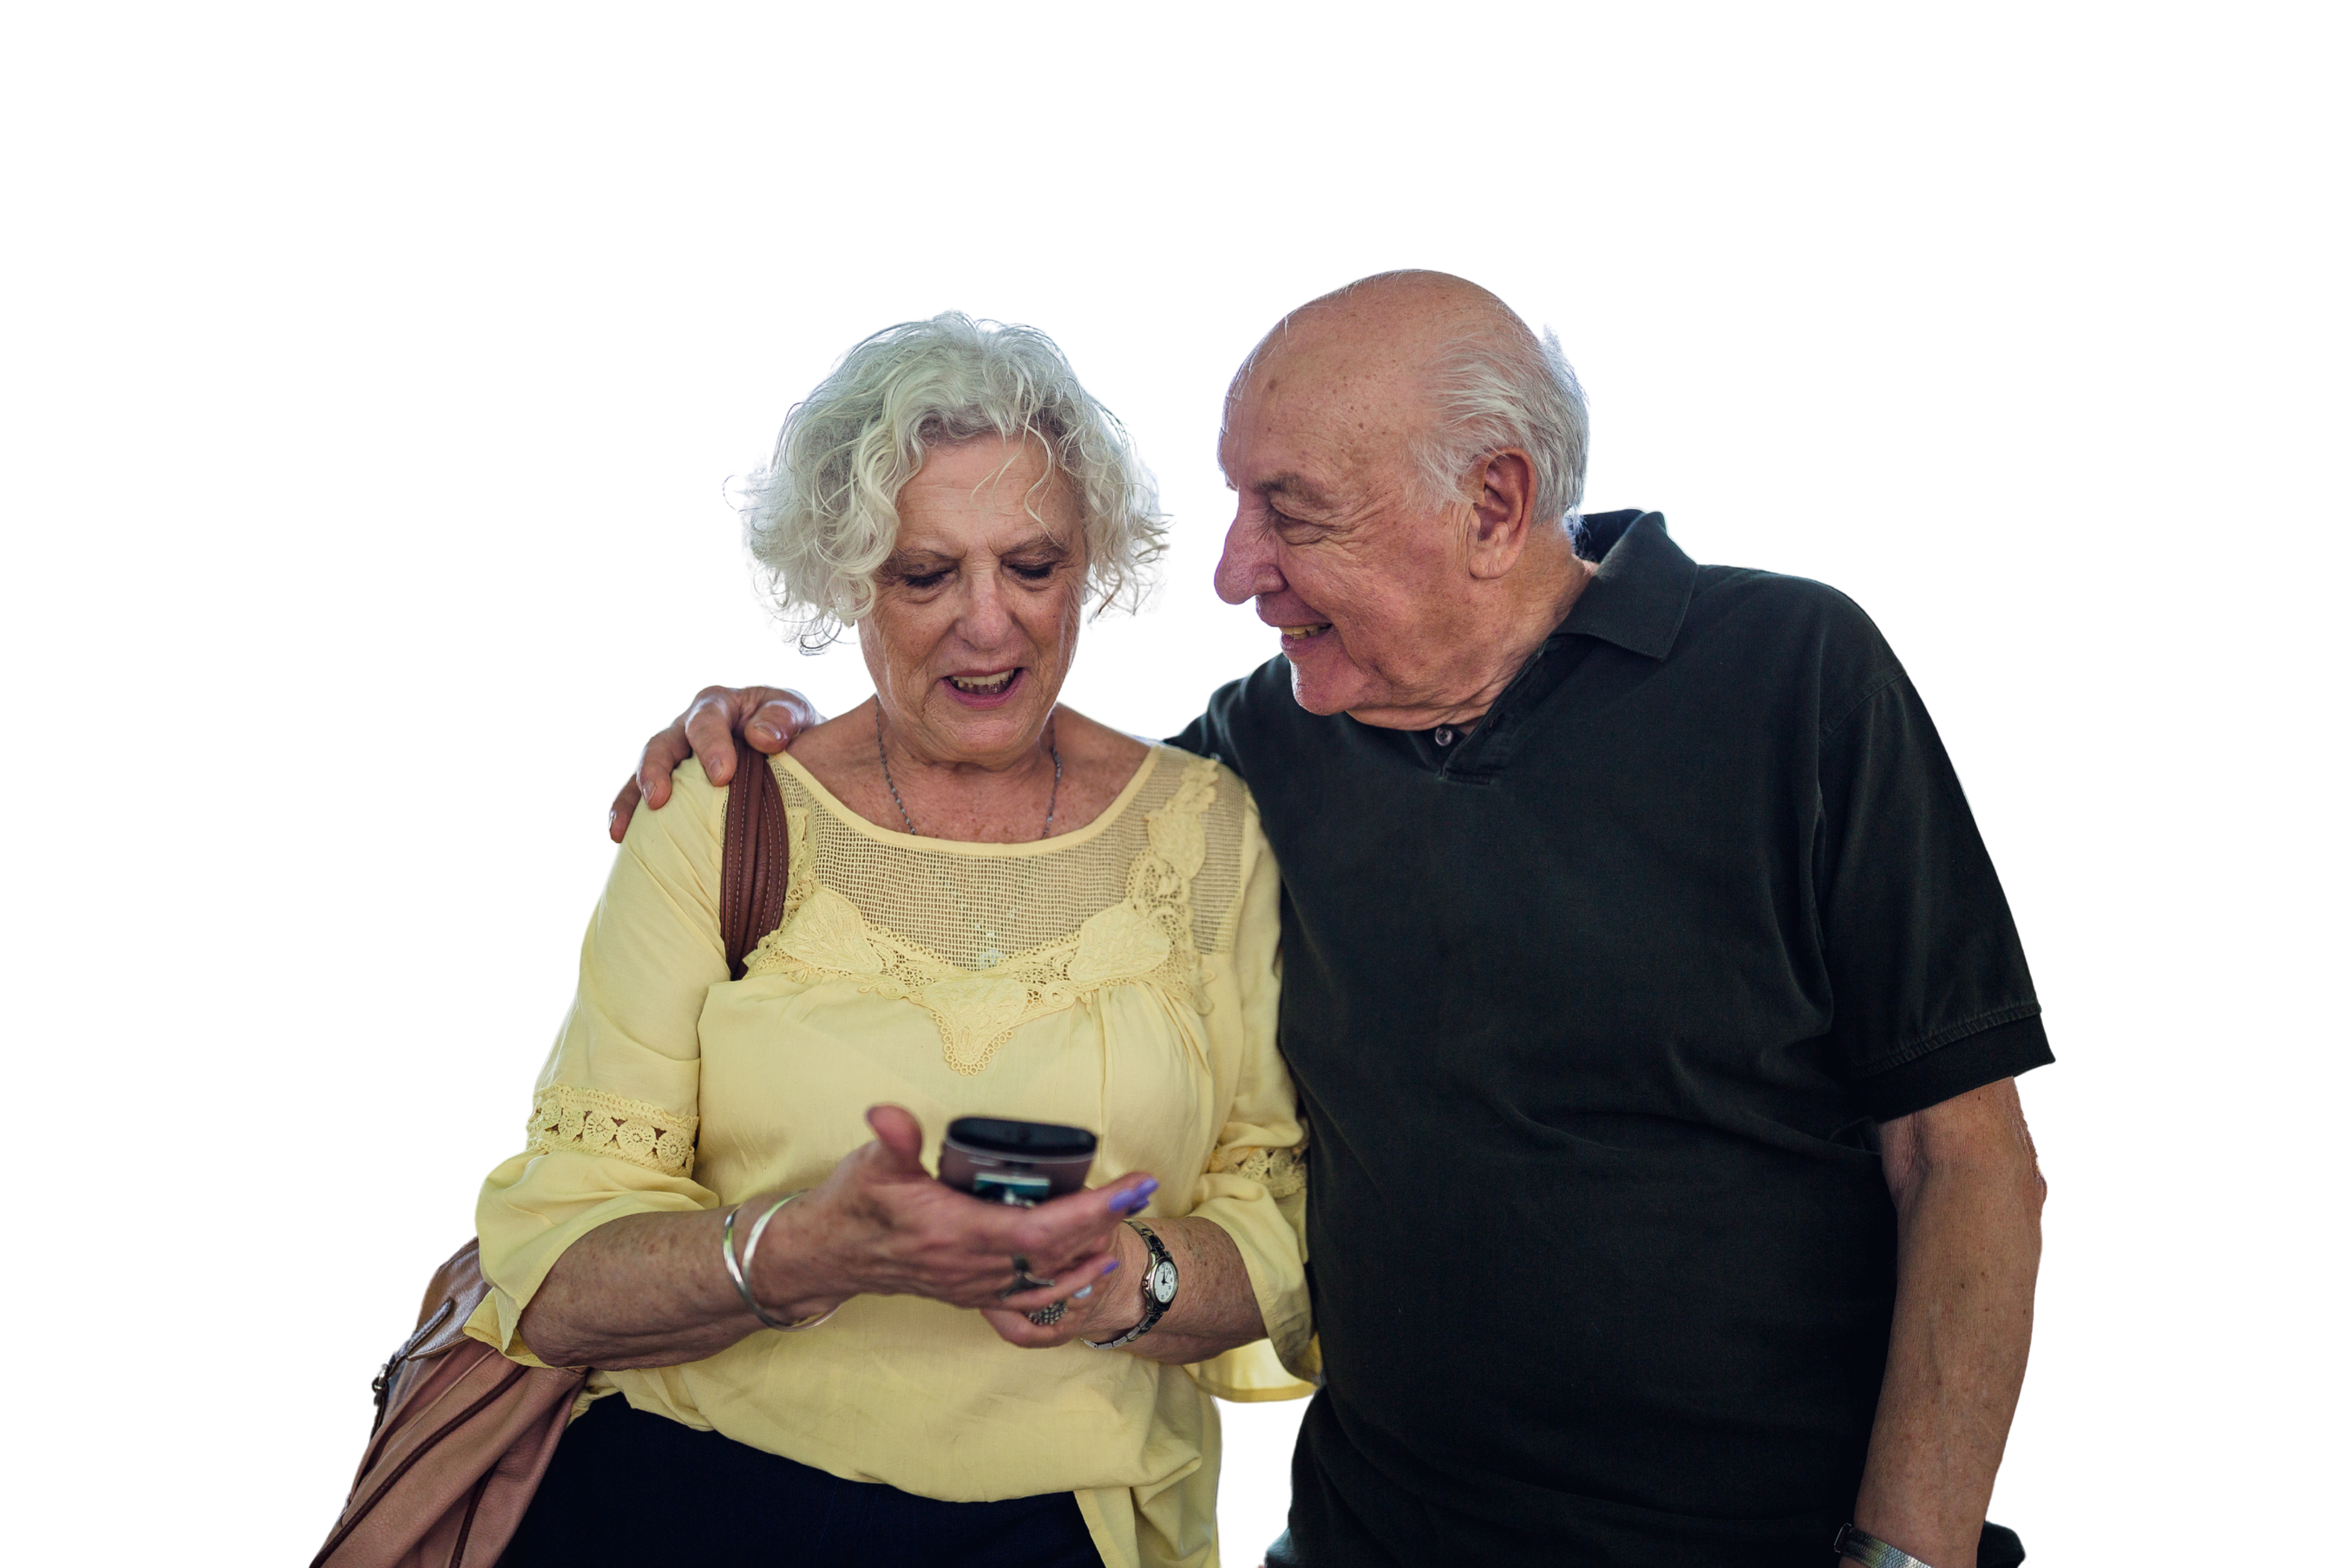
Happy
Get Online Week!
This event is part of a nation wide campaign to support people to feel safer and more confident online

Slide 5

Music programs
  Have you used YouTube to listen to music?
  What about streaming services (like Spotify, Apple Music)?

Slide 6

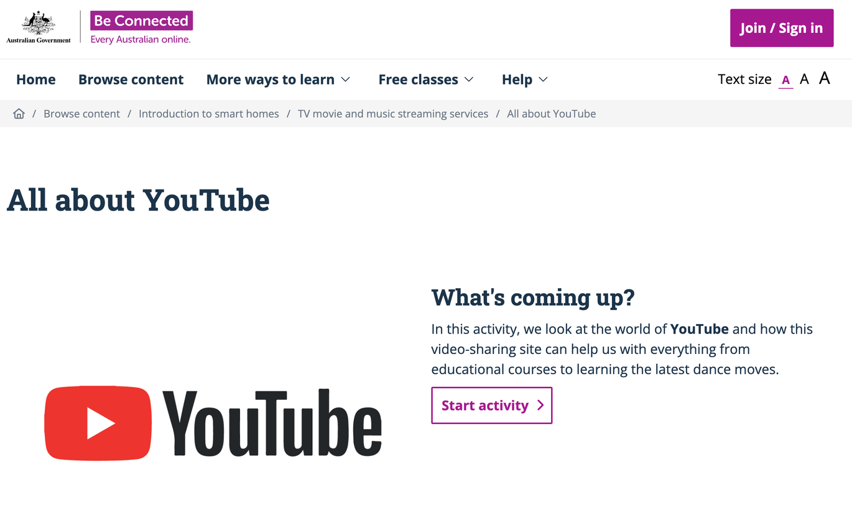
Learning about YouTube
Visit Be Connected to learn more about YouTube.
Be Connected All about YouTube course

Slide 7


Go on YouTube!

Slide 8

Your turn: Karaoke time!
  Search your favourite song on YouTube. Remember to include ‘karaoke’ at the end of your search
  Sing along!
  Bonus: What else could you look up on YouTube?

Slide 9

Safety tip: Remember to double check information you find online! It is not always accurate or reliable.

Slide 10

Questions?
Share one thing that you learnt today

Slide 11
Our next session
Topic:
Time:
Date:

Slide 12
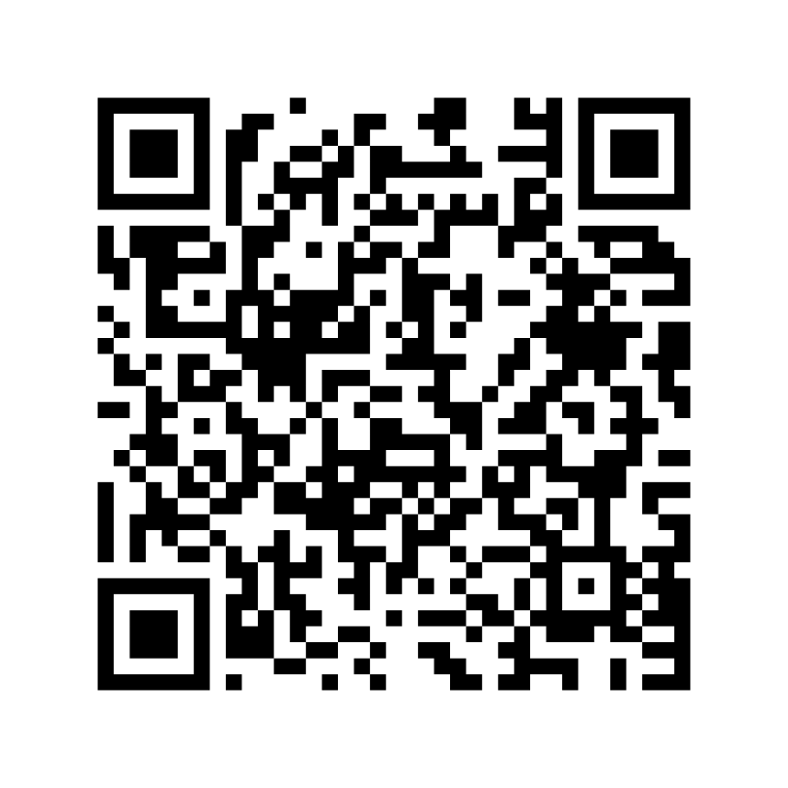
Share your feedback
  Help Good Things know the impact of Get Online Week
  Scan the QR code or go to this website
my.goodthingsaustralia.org/s/gow-event-survey

Slide 13



Learn more good things
www.goodthingsaustralia.org
beconnected.esafety.gov.au

