Slide 1









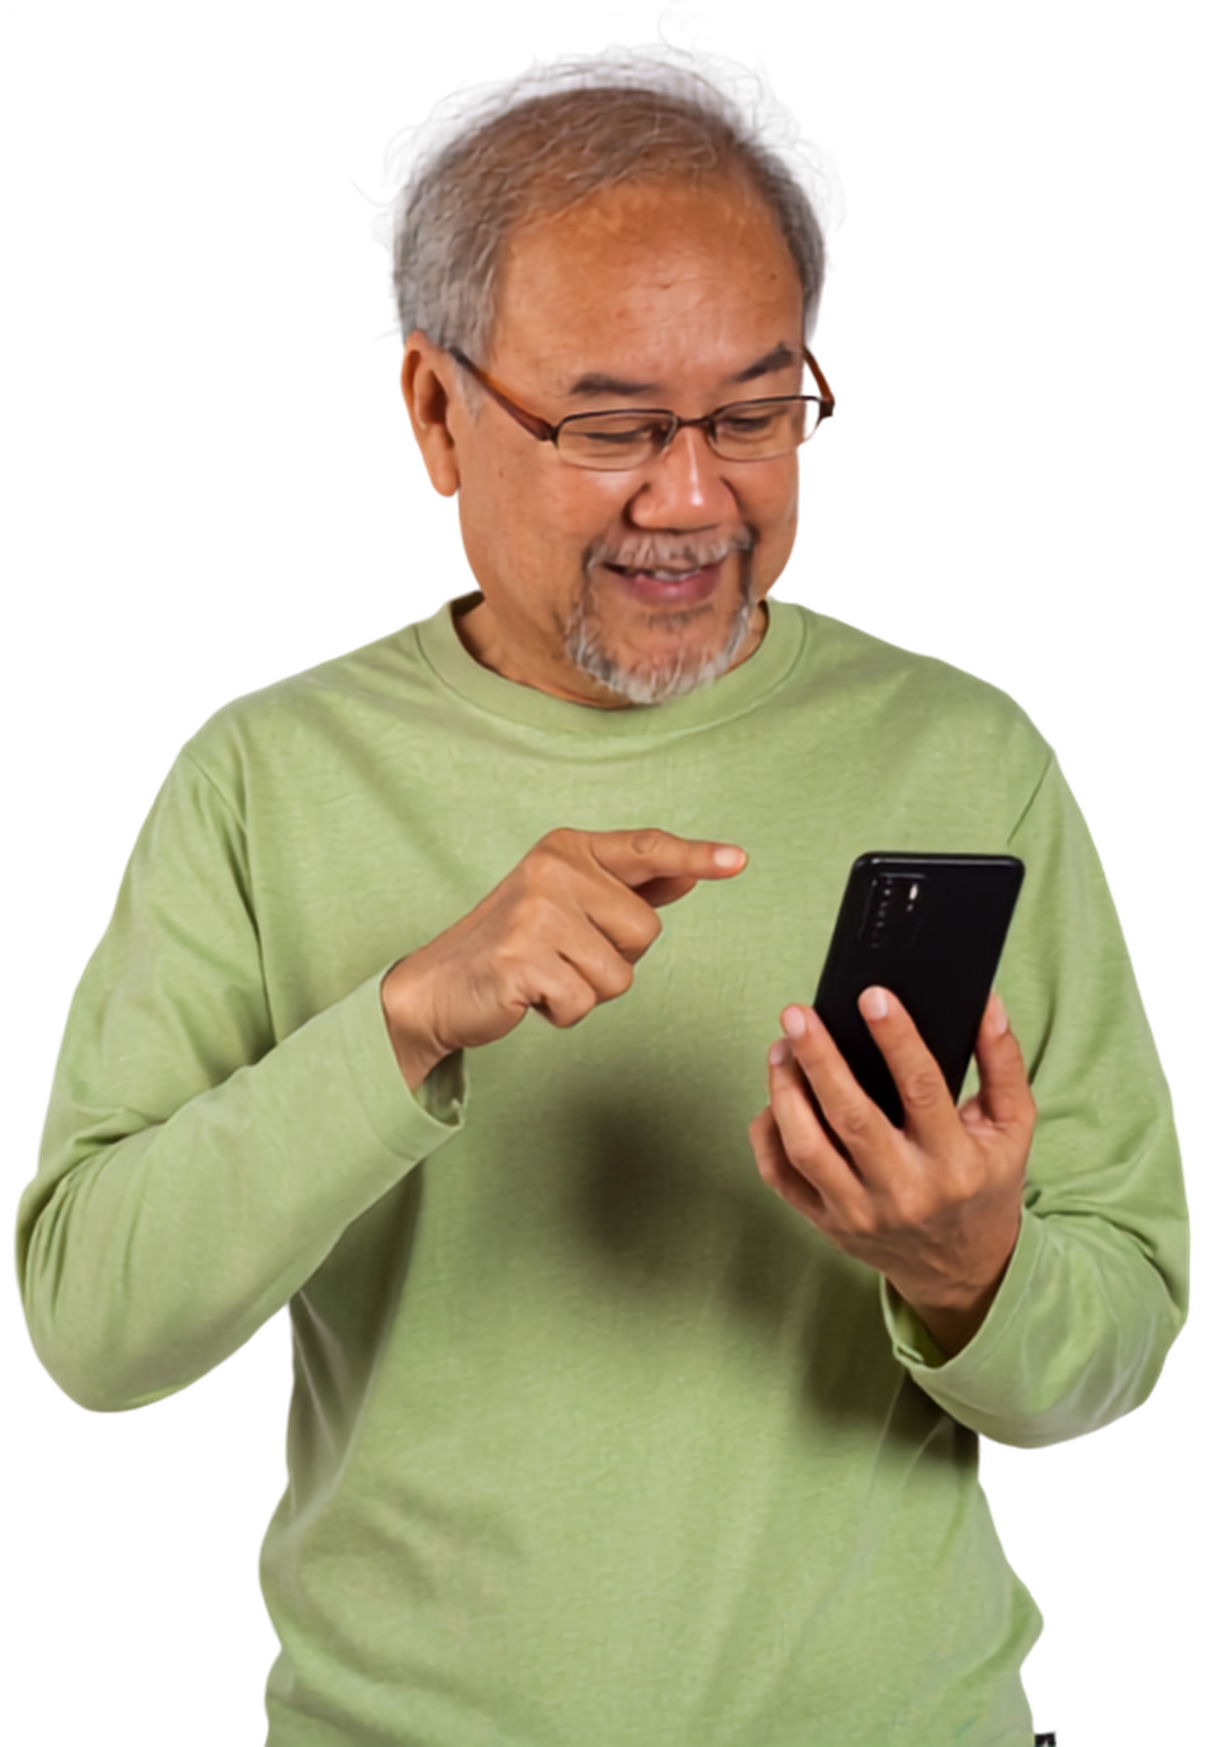




Fuel price apps and websites
Add your logo here

Slide 2


Acknowledgement of Country
We acknowledge the traditional custodians of the land and pay our respect to Elders past and present and extend that respect to Aboriginal and Torres Strait Islander peoples joining us today.
Image credit: Urtakerte/Heart indigemoji
Artist: Dreamtime Ladie by Kathleen Kemarre Wallace with Graham Wilfred
Download Indigenous emojis at www.indigemoji.com.au

Slide 3


Icebreaker!
  Introduce yourself
  How do you check petrol prices?

Slide 4
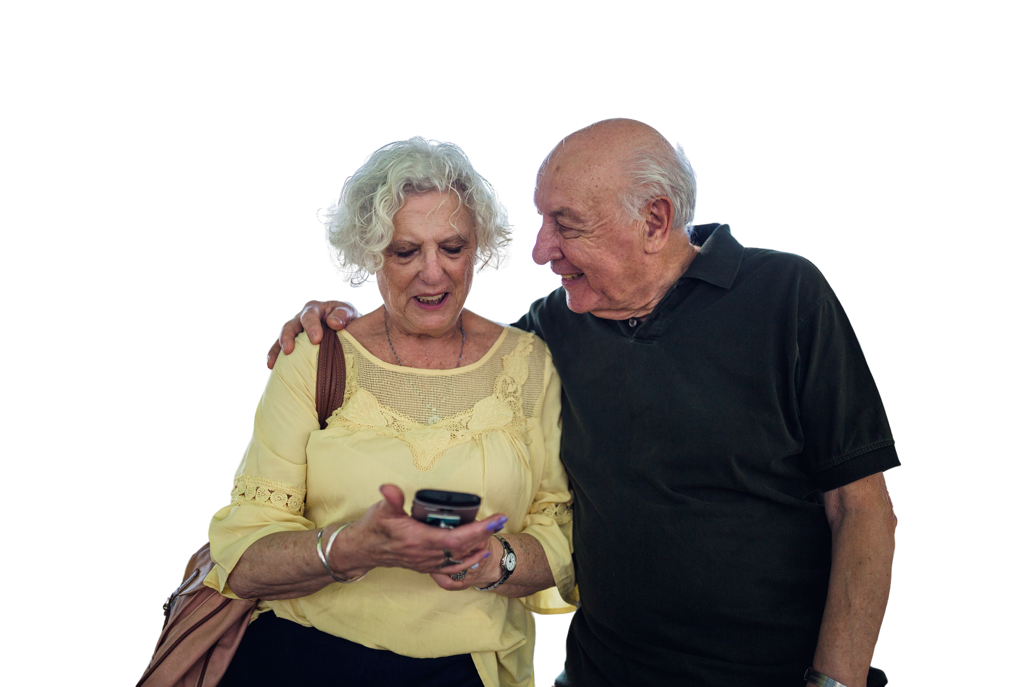
Happy
Get Online Week!
This event is part of a nation wide campaign to support people to feel safer and more confident online

Slide 5
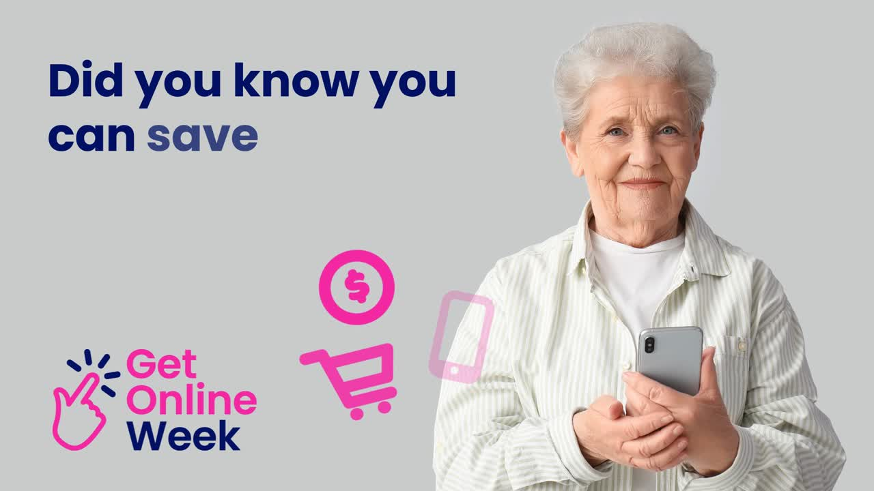

Slide 6

How to save money on petrol
Fuel apps and websites help you to find the cheapest petrol that day

Slide 7

Look it up!
Find the fuel price comparison app or website for your state or territory on Be Connected
beconnected.esafety.gov.au
Be Connected How to save money on petrol article

Slide 8

Safety tip: Only download apps from the official Apple App Store or Google Play Store

Slide 9

Your turn: Fuel price bingo!
  Download your state or territory’s fuel price app from an official app store or go to their official website
  Enter your postcode
  Find 3 of the cheapest petrol stations in the area
  Raise your hand when you’re done!

Slide 10

Questions?
Share one thing that you have learnt today!

Slide 11
Our next session
Topic:
Time:
Date:

Slide 12
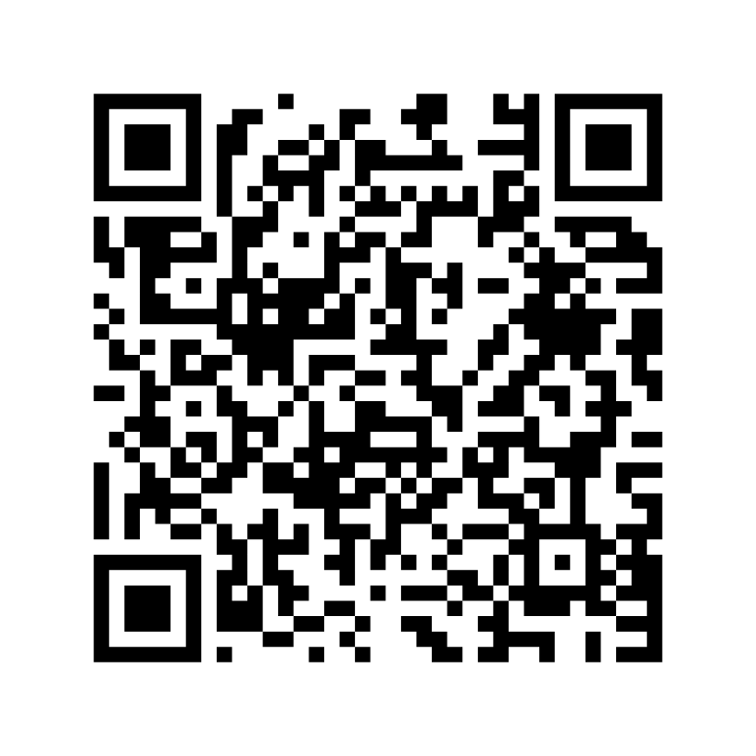
Share your feedback
  Help Good Things know the impact of Get Online Week
  Scan the QR code or go to this website
my.goodthingsaustralia.org/s/gow-event-survey

Slide 13



Learn more good things
www.goodthingsaustralia.org
beconnected.esafety.gov.au

