Slide 1














Be a scam detective
Add your logo here

Slide 2


Acknowledgement of Country
We acknowledge the traditional custodians of the land and pay our respect to Elders past and present and extend that respect to Aboriginal and Torres Strait Islander peoples joining us today.
Image credit: Urtakerte/Heart indigemoji
Artist: Dreamtime Ladie by Kathleen Kemarre Wallace with Graham Wilfred
Download Indigenous emojis at www.indigemoji.com.au

Slide 3


Icebreaker!
  Introduce yourself
  Thumbs up or thumbs down game

Slide 4
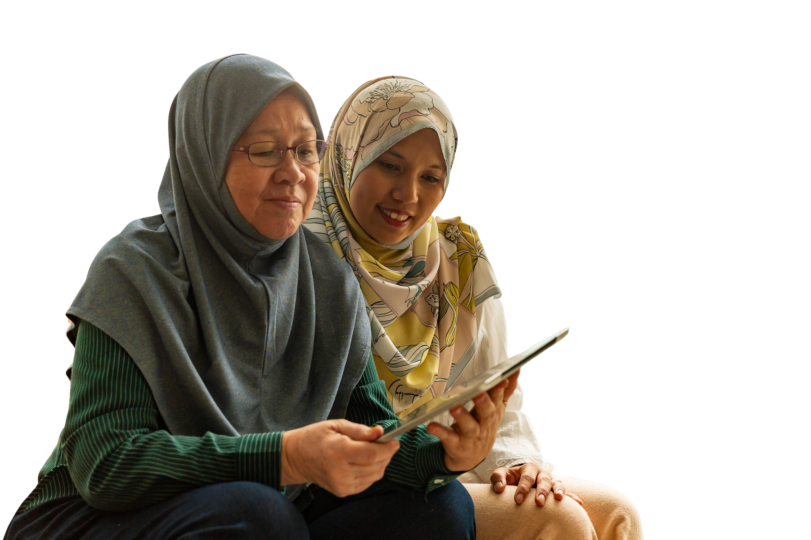
Happy
Get Online Week!
This event is part of a nation wide campaign to support people to feel safer and more confident online

Slide 5

What do you know about scams?
Have you ever received a scam text message or email? Share your experience with scams

Slide 6

Safety tip: Remember not everything you see on your phone or online is real. Some people are trying to trick you!

Slide 7
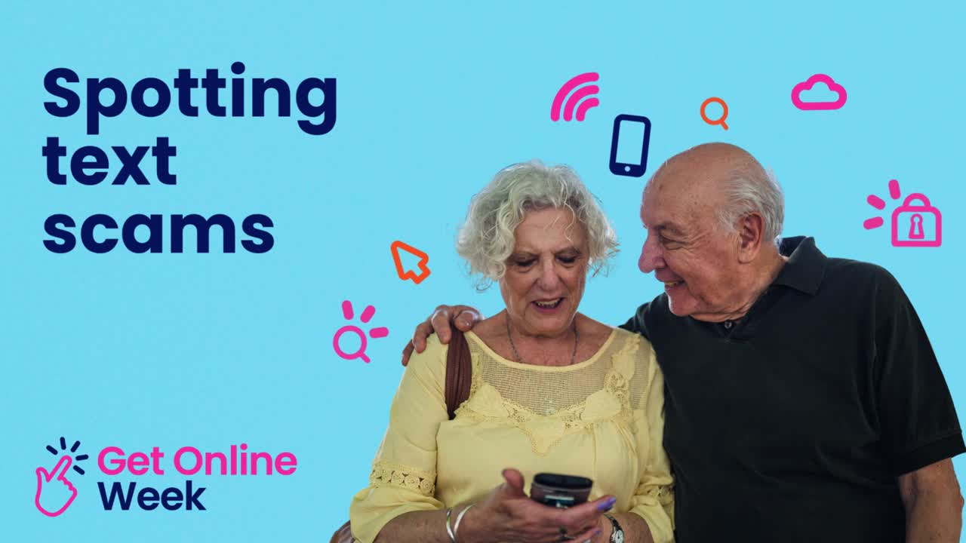

Slide 8

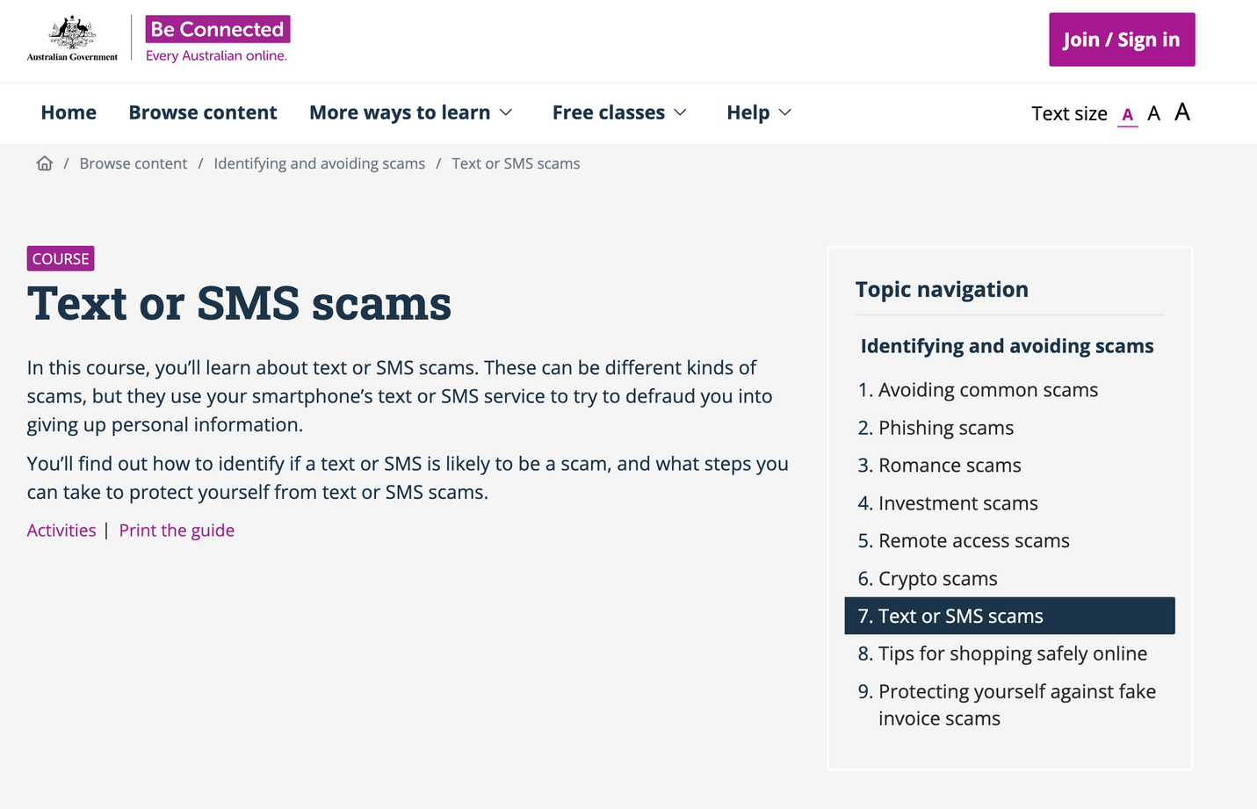
Learning how to spot a text scam
Visit Be Connected to learn more about how to identify text or SMS scam.
Be Connected Text or SMS scams course

Slide 9
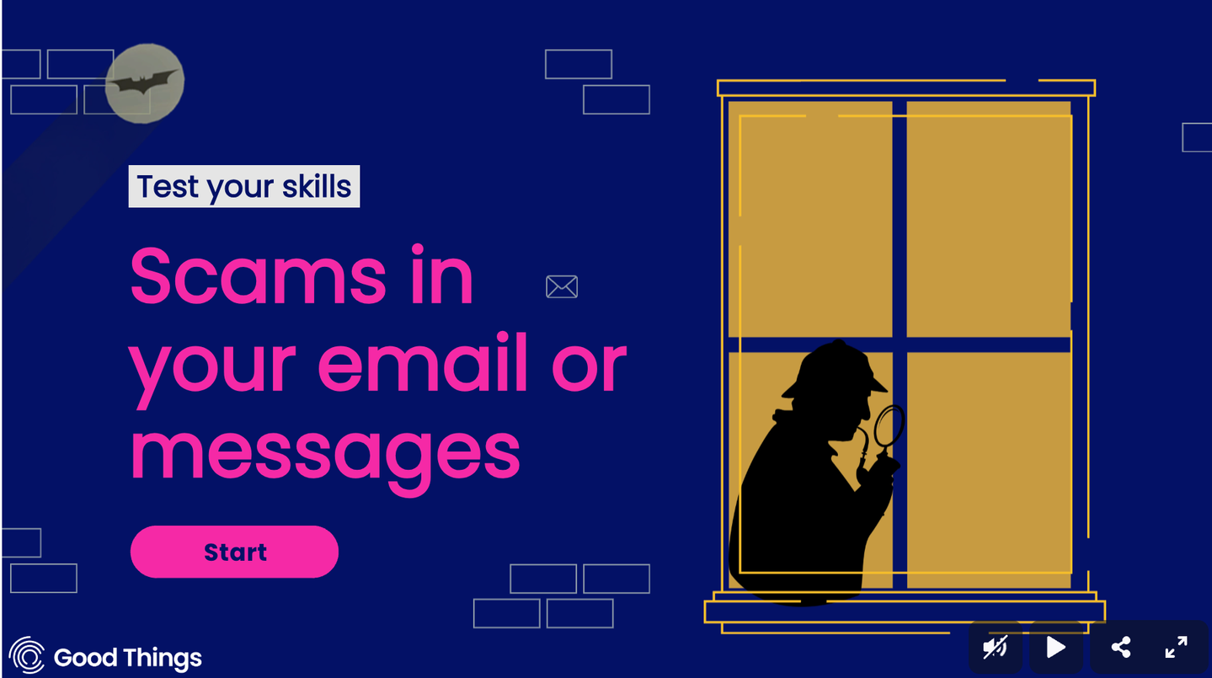
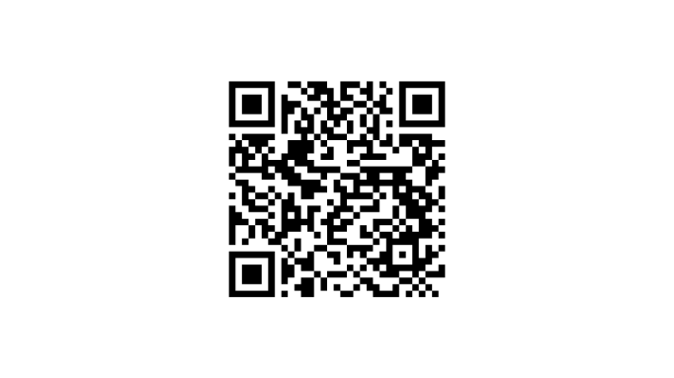

Play the Scam Detective game
Scan the QR code to play!

Slide 10

Your turn: Search for a scam
Look at your text messages and see if you can spot a scam message. Remember be careful and do not click on any links!

Slide 11

Questions?
Share one thing that you have learnt today!

Slide 12
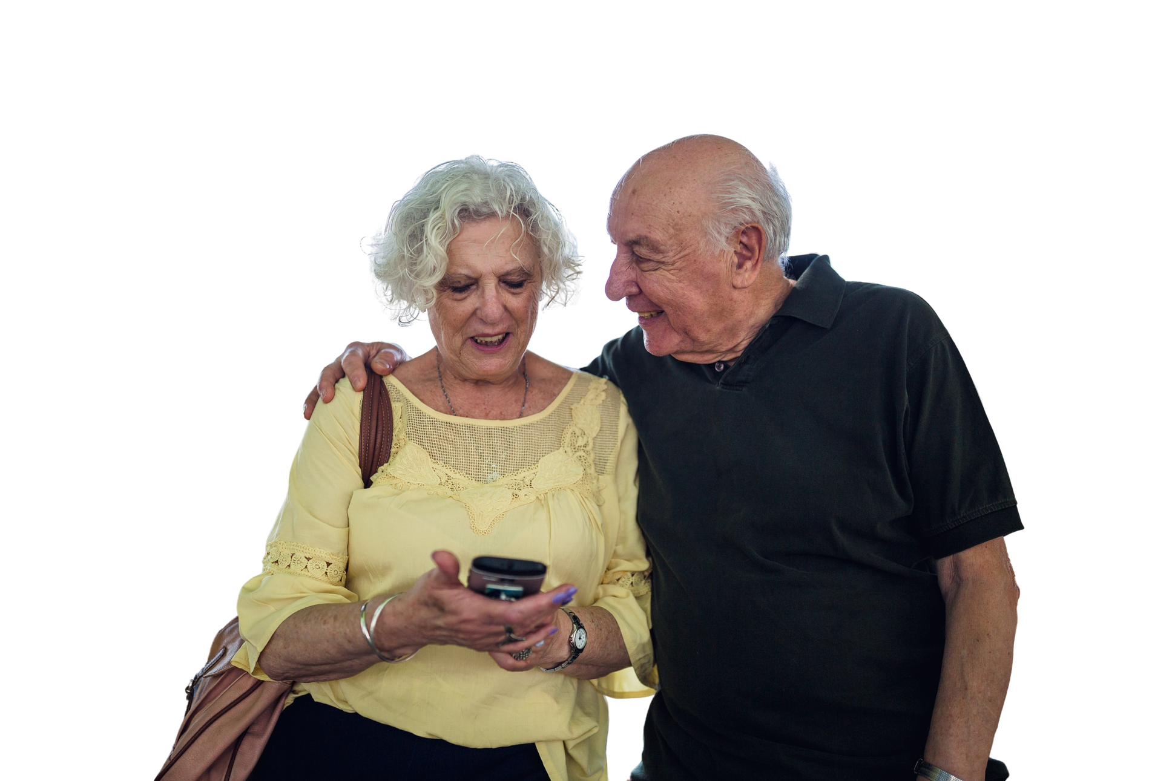
Our next session
Topic:
Time:
Date:

Slide 13
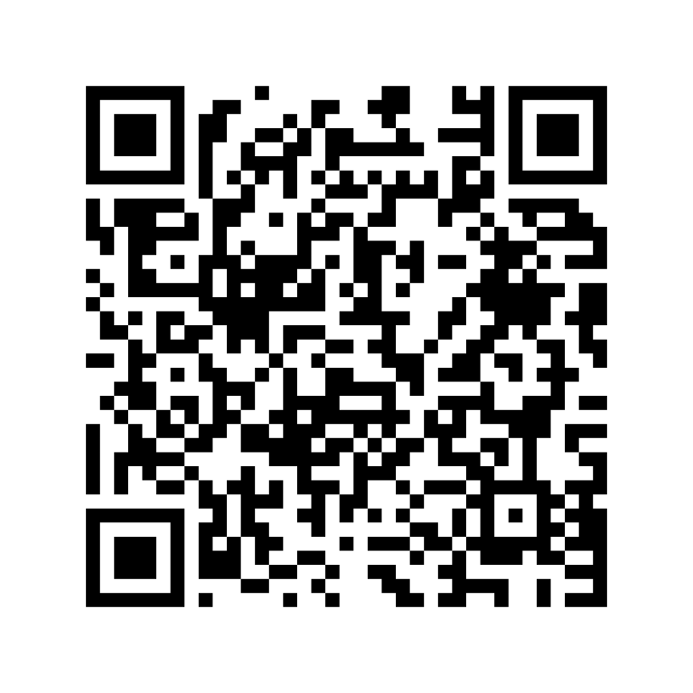
Share your feedback
  Help Good Things know the impact of Get Online Week
  Scan the QR code or go to this website
my.goodthingsaustralia.org/s/gow-event-survey

Slide 14



Learn more good things
www.goodthingsaustralia.org
beconnected.esafety.gov.au

