Slide 1










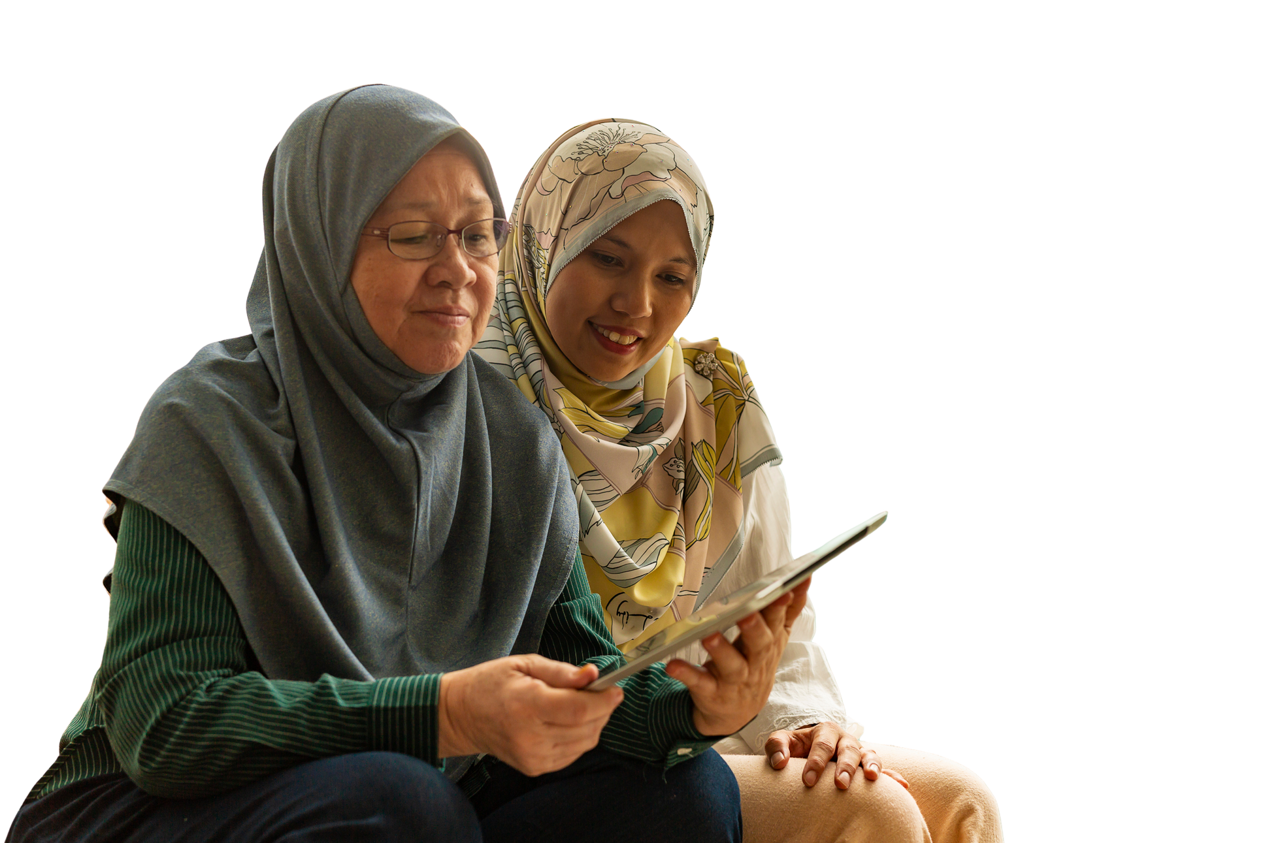



AI prompt recipe
Add your logo here

Slide 2

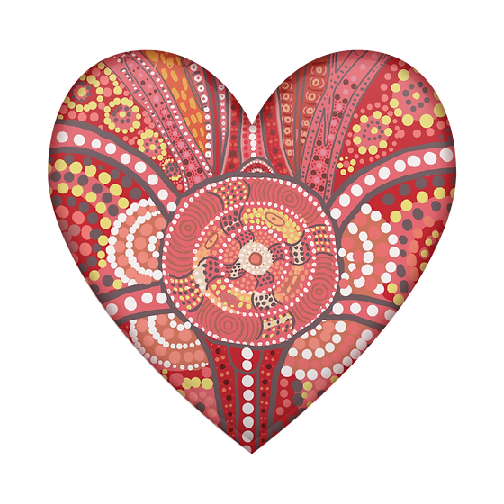
Acknowledgement of Country
We acknowledge the traditional custodians of the land and pay our respect to Elders past and present and extend that respect to Aboriginal and Torres Strait Islander peoples joining us today.
Image credit: Urtakerte/Heart indigemoji
Artist: Dreamtime Ladie by Kathleen Kemarre Wallace with Graham Wilfred
Download Indigenous emojis at www.indigemoji.com.au

Slide 3


Icebreaker!
  Introduce yourself
  Share one thing you have used AI for
  If you have not used AI, share one thing you want to use it for

Slide 4
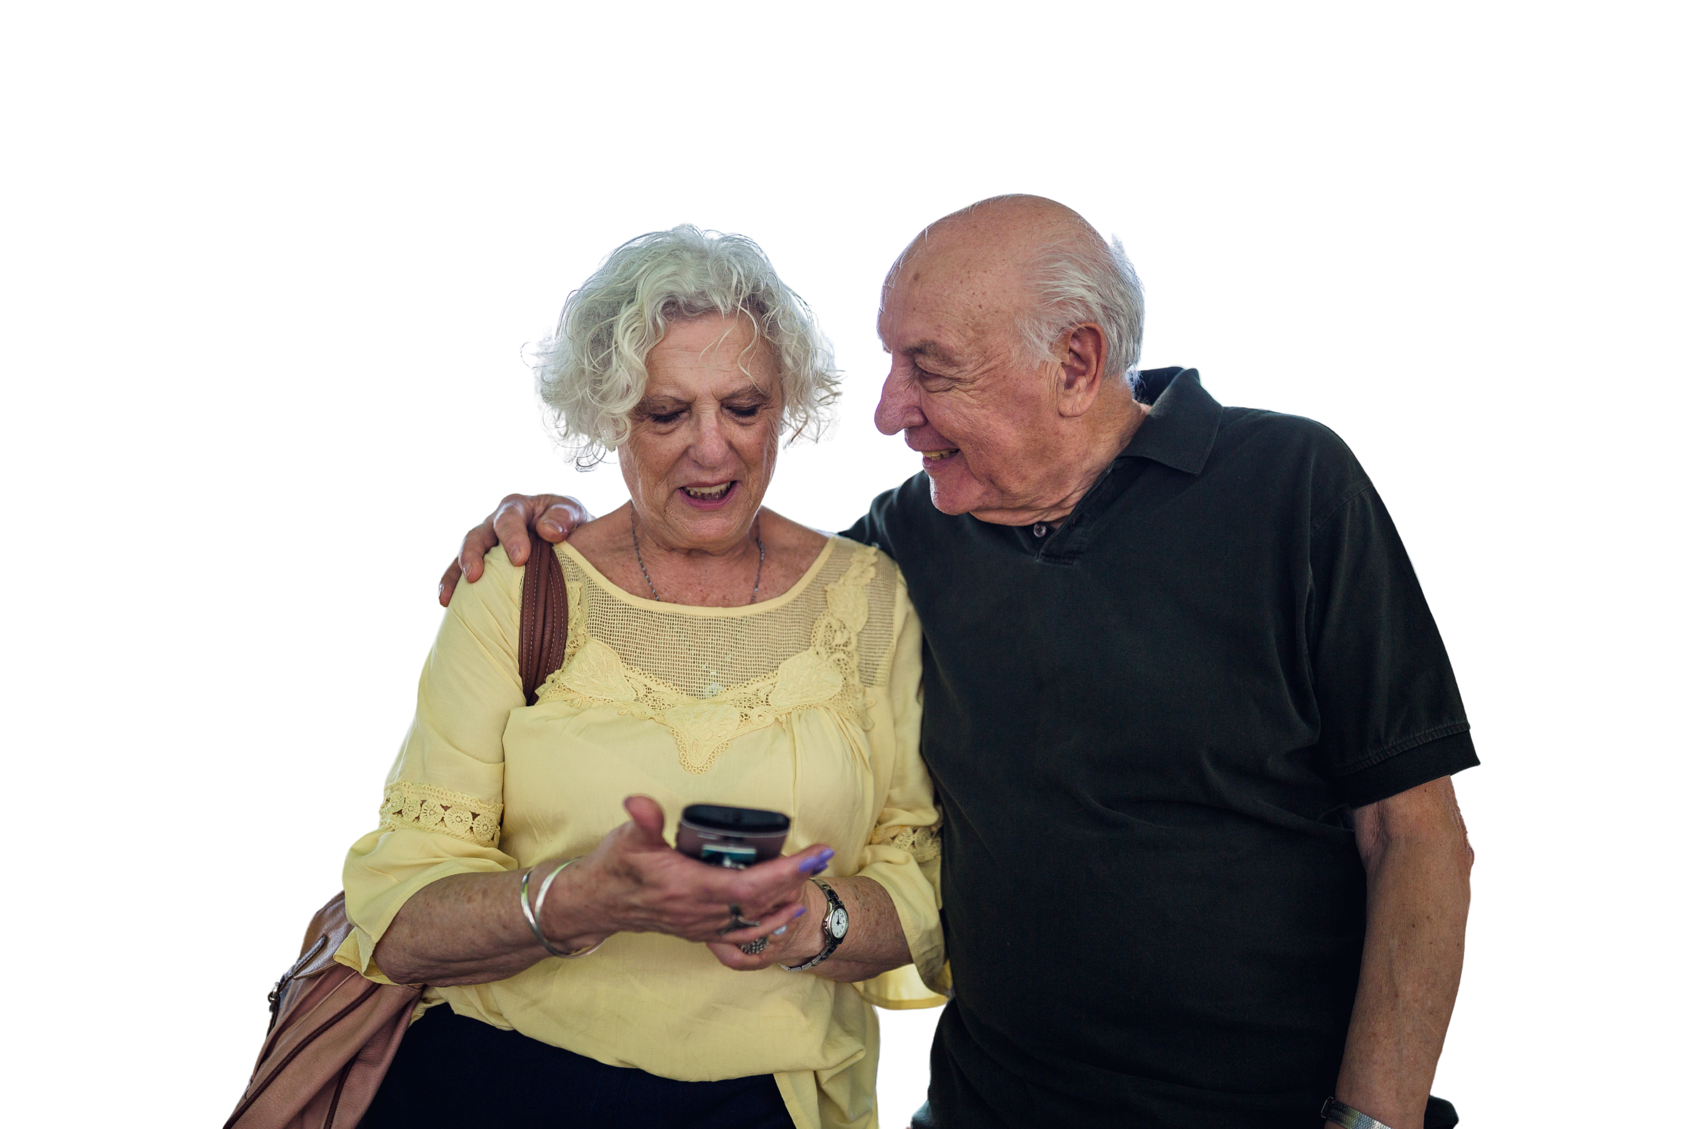
Happy
Get Online Week!
This event is part of a nation wide campaign to support people to feel safer and more confident online

Slide 5
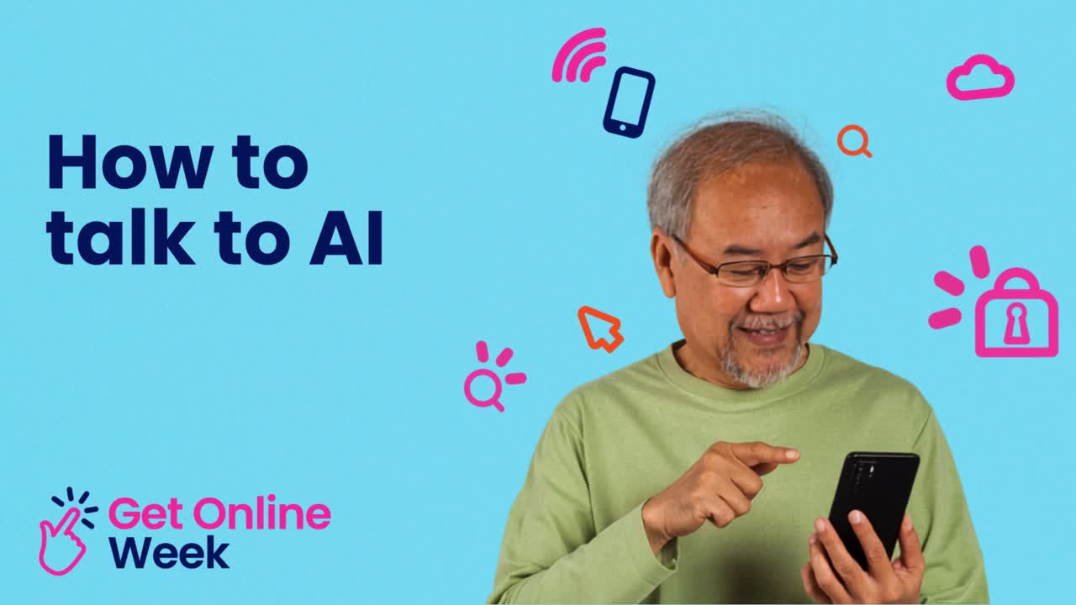

Slide 6

How to ask AI to do what you want
  Start with what you want it to do
  Add in ‘Who’ you want it to pretend to be
  Add ‘How’ you want it done
  And ‘What’ you want it to say
  Check what it came up with is ok!

Slide 7

Safety tip: Remember to double check what AI says! It is not always accurate or reliable.

Slide 8

Your turn: AI art gallery
  Go to the AI art gallery
  Select the ‘+ Post’ button on the bottom left corner
  Type in your prompt and the title of your artwork
  Select ‘Publish’

Slide 9

Questions?
Share one thing that you have learnt today!

Slide 10

Our next session
Topic:
Time:
Date:

Slide 11
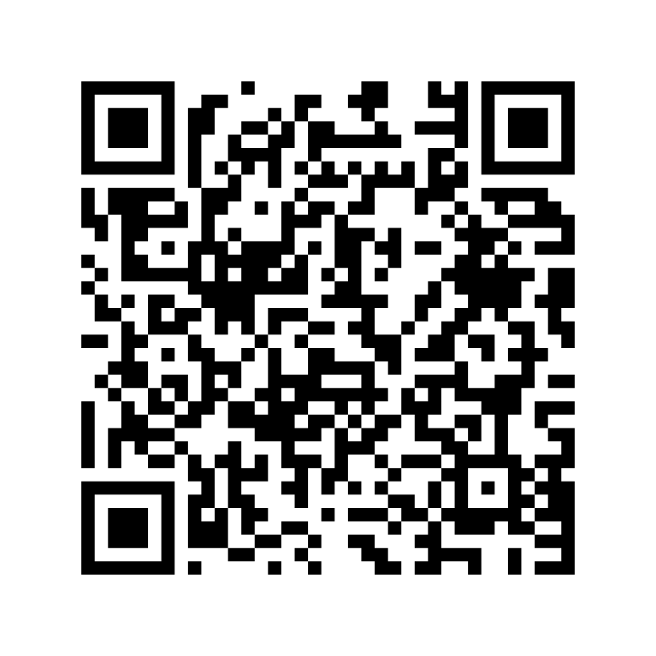
Share your feedback
  Help Good Things know the impact of Get Online Week
  Scan the QR code or go to this website
my.goodthingsaustralia.org/s/gow-event-survey

Slide 12



Learn more good things
www.goodthingsaustralia.org
beconnected.esafety.gov.au
Supported by

