Slide 1





Introduction
to Artificial Intelligence (AI)

Slide 2


Acknowledgement of Country
We acknowledge the traditional custodians of the land and pay our respect to Elders past and present and extend that respect to Aboriginal and Torres Strait Islander peoples joining us today.
Image credit: Urtakerte/Heart indigemoji
Artist: Dreamtime Ladie by Kathleen Kemarre Wallace with Graham Wilfred
Download Indigenous emojis at www.indigemoji.com.au

Slide 3


Icebreaker
Introduce yourself and share:
  Your name
  What do you do?
  Why do you think learning more about AI is important?

Slide 4

Agenda
In today‘s session, we will be covering:
  What is AI?
  Benefits of using AI in everyday life
  Staying safe online

Slide 5

What is AI?

Slide 6

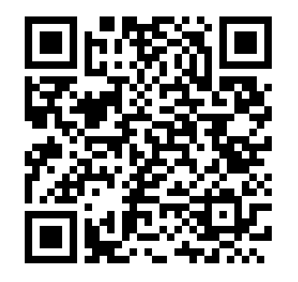
Test your knowledge
Let’s start off with a short quiz game called ‘Do you know about AI’.
Scan the QR code with your phone, or use the link provided by your facilitator.

Slide 7

Where is AI now?
Watch this short video to see where AI may be appearing in your life.

Slide 8
Benefits of using AI
in daily life

Slide 9

How AI can help you
  Translate into different languages
  Find a new job
  Learn something new
  Set reminders and schedule events
  Find your way
  Cook like a pro
  Stay active

Slide 10

Examples of AI use in daily life
  Michelle uses a grocery app to help create her shopping lists
  Daniel uses a fitness tracker to check his heart and sleep
  Amina uses language apps to learn English
  Ahmed uses a smart pet feeder to schedule feedings for his dog

Slide 11


AI has pros and cons
Below are some (not all) advantages and disadvantages of AI.
Disadvantages:
  Job displacement
  Ethical concerns
  Dependence on tech
Advantages:
  Efficiency
  Cost savings

Slide 12

Important reminder
As you can see, although AI is beneficial, it has some risks that we need to stay safe from.
Lets take a look at how you can do that together.

Slide 13
Staying safe online

Slide 14
How to stay safe online
Here are some simple tips to get you started on staying safe online.

Slide 15

Top tips for staying safe online
  Use strong passwords
  Limit your social media
  Perform virus and security updates
  Learn about scams to be aware of
  Keep learning!

Slide 16

Types of scams to be aware of
  Phishing scams
  AI chat bots
  Job scams
  Online shopping scams
  Tech support scams
  Online romance scams
  Investment scams
  Lottery/prize scams

Slide 17


Do you have any questions?

Slide 18


Thank you.

