Slide 1





Introduction
to Artificial Intelligence (AI)

Slide 2


Acknowledgement of Country
We acknowledge the traditional custodians of the land and pay our respect to Elders past and present and extend that respect to Aboriginal and Torres Strait Islander peoples joining us today.
Image credit: Urtakerte/Heart indigemoji
Artist: Dreamtime Ladie by Kathleen Kemarre Wallace with Graham Wilfred
Download Indigenous emojis at www.indigemoji.com.au

Slide 3

Agenda
In today‘s session, we will be covering:
  Introduction to AI
  AI Safety
  Spotting AI Images and Videos

Slide 4

Introduction to AI

Slide 5


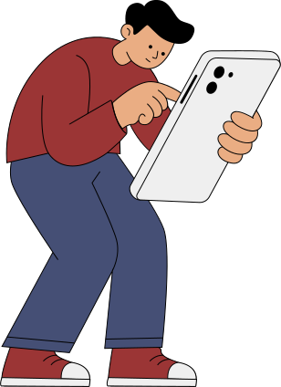

Brainstorming
What do you think Artificial Intelligence (AI) means?
Where do you think we already use AI in everyday life?
Have you used AI tools before? Which one?

Slide 6
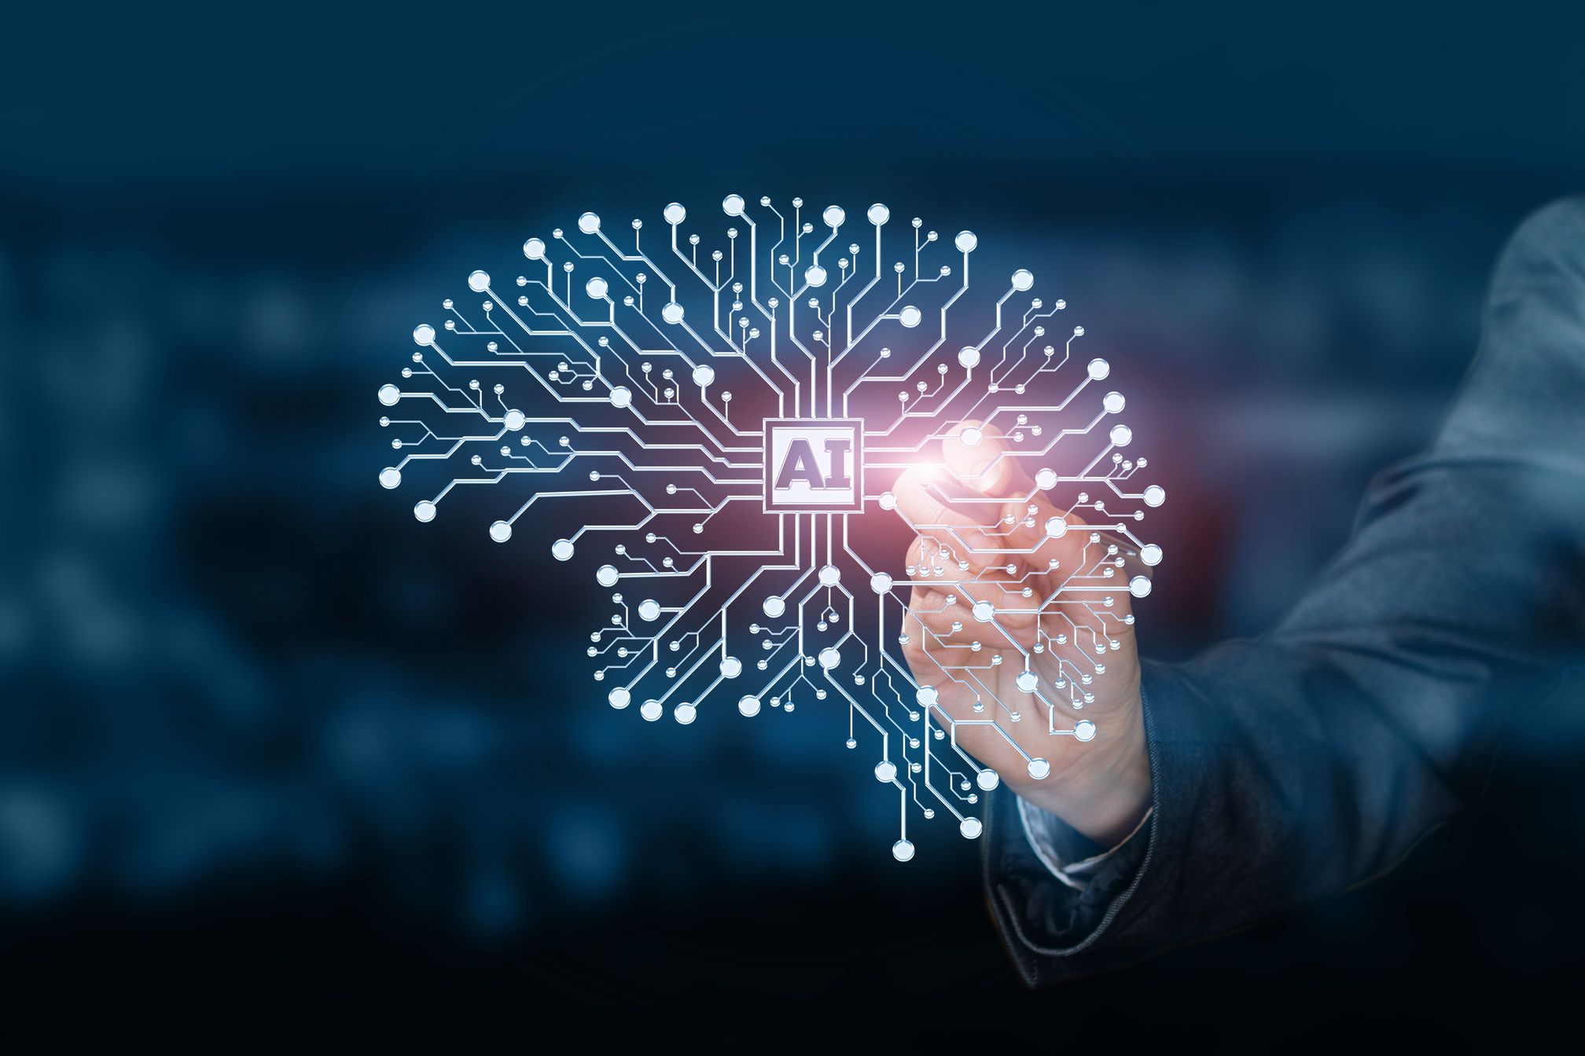
What is AI?
Artificial Intelligence is like a smart helper that lives in your computer or phone. It learns from data to help you with tasks and make your life easier.
How AI works:
AI learns by recognising patterns in data. This helps it make decisions or predictions.

Slide 7

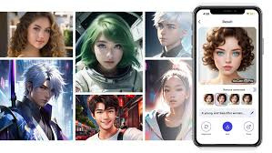
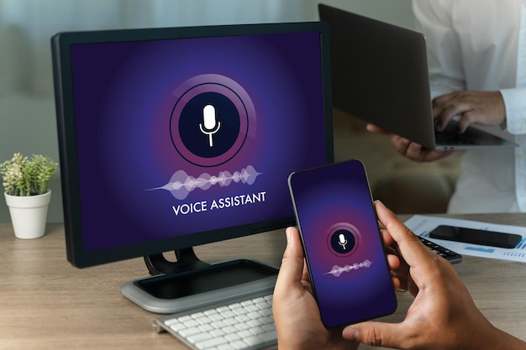

Different types of AI Tools
There are many different types of AI Tools that aim to do different things. These can include:
  Chatbots like ChatGPT
  Translators like Google Translate
  Voice Assistance
  Image generators.

Slide 8
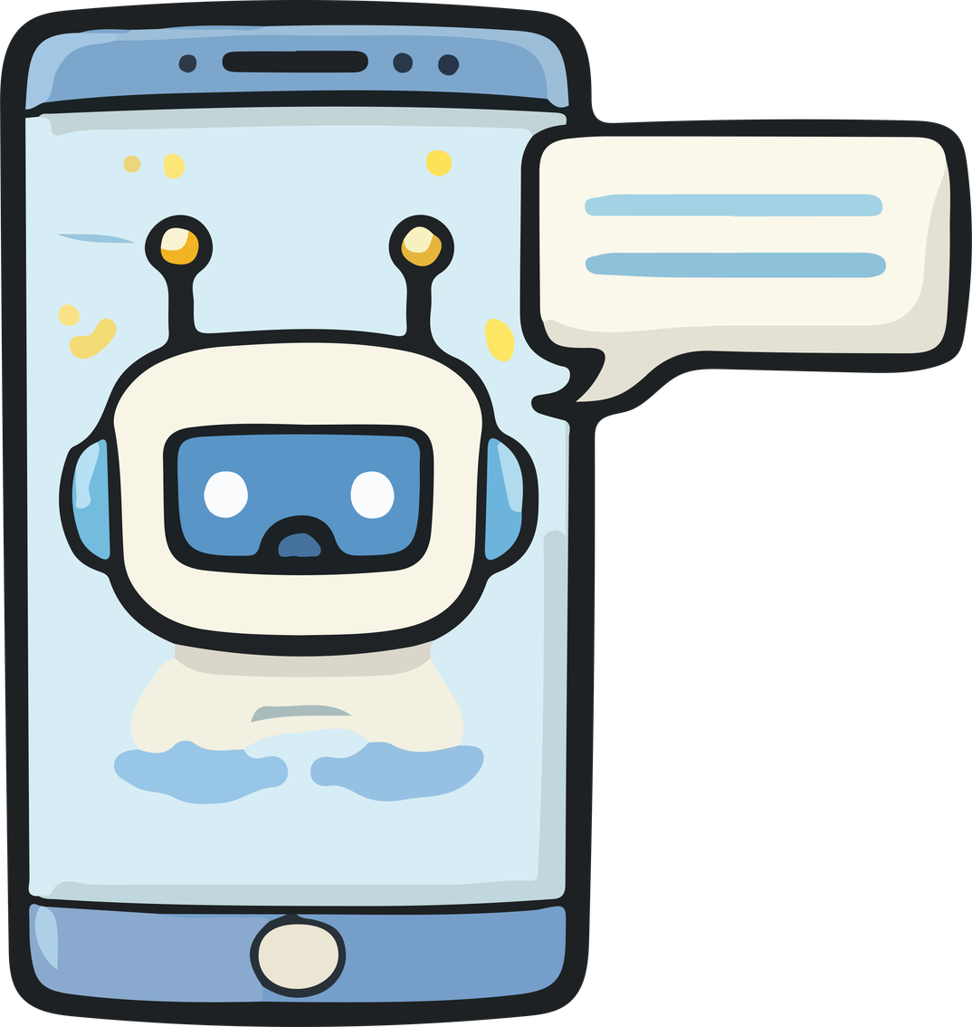
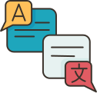


Different types of AI Tools
Chatbots: Tools you can "talk" to that answer questions and help you get tasks done.
Translators: Apps that instantly change words from one language to another.
Voice Assistants: Systems that listen to your voice and do what you ask, like setting an alarm or playing music.
Image Generators: Tools that create a picture for you based on a simple description you type in.

Slide 9

Advantages of AI
AI can act as a personal assistant that makes your life easier by handling the heavy lifting of daily tasks and learning. Things it can do include:
  24x7 Availability
  Saves time
  Helps with writing and research
  Assists with learning new skills
  Can support work and daily task

Slide 10

Disdvantages of AI
It is also important to stay aware of the risks, as AI is still a developing technology that requires careful use. Things to look out for include:
  Information may sometimes be incorrect
  Privacy concerns
  Over-reliance on technology
  Ethical issues (fake images or misinformation)
  Job displacement
  Ethical concerns

Slide 11
AI Safety

Slide 12




How to use AI Safely
Protect personal information. Don’t share passwords, private data, or sensitive details with AI tools.
Think critically.
AI can make mistakes, so always double-check important information.
Use AI as a helper.
Let AI support learning, brainstorming, and productivity, but keep human judgment.
Use trusted AI tools.
Choose reliable platforms with clear privacy policies.

Slide 13



How to use AI Ethically
Don’t use AI to cheat.
Don’t use AI to create fake news, scams, bullying content, or harmful material.
Be responsible.
Think about how AI content might affect others before sharing it.
Respect others’ privacy.
Don’t upload photos, documents, or data about people without permission.

Slide 14

Where to report AI issues
  Government AI tools: Report to the relevant government agency or department
  Privacy or data concerns: Office of the Australian Information Commissioner (OAIC)
  Scams or misleading AI content: Scamwatch (ACCC)
  Harmful or unsafe online AI content: eSafety Commissioner

Slide 15

Where to report AI issues
If you’re feeling unsure or worried about something you’ve seen with AI, it’s always best to chat with someone you trust, like a caseworker or a teacher, to help you figure it out.

Slide 16

Break

Slide 17
Spotting AI Images and
Videos

Slide 18

AI Image Quiz
Can you spot the AI images?
Test your skills by playing this game.

Slide 19
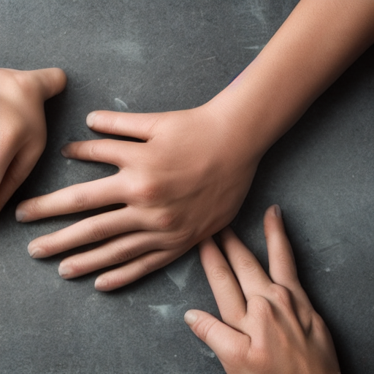

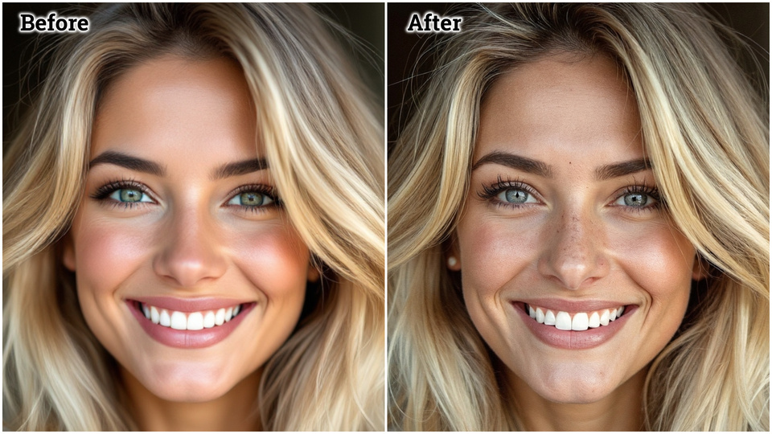
Tips for looking for AI generated pictures
  Look for extra/missing or merged fingers
  Hands in unnatural positions
  Skin looks too smooth or plastic
  Teeth looks too smooth or plastic
  Earrings may be different on each side
There are many more things you can look out for! Try asking a Chatbot for more clues to look for.

Slide 20

Tips for looking for AI generated videos
  Strange facial movements e.g. mouth not matching speech
  Movement may look slightly delayed
  Eyes blinking unnaturally or not blinking
  Face edges flickering
  Glitches in hands
  Shifts in backgrounds
  Unnatural movement e.g. people walking without their limbs movings

Slide 21

Tips for staying safe
  Don’t trust everything you see online
  Check the sources (websites, accounts)
  Look for confirmation from trusted news
There are also some AI-generated content detection tools like Hive if you were interested in getting a tool.

Slide 22

Do you have any questions?

Slide 23


Thank you.

