Slide 1





AI in Action
Hands-on with the latest platforms

Slide 2


Acknowledgement of Country
We acknowledge the traditional custodians of the land and pay our respect to Elders past and present and extend that respect to Aboriginal and Torres Strait Islander peoples joining us today.
Image credit: Urtakerte/Heart indigemoji
Artist: Dreamtime Ladie by Kathleen Kemarre Wallace with Graham Wilfred
Download Indigenous emojis at www.indigemoji.com.au

Slide 3

Agenda
In today‘s session, we will be covering:
  Welcome and overview
  Microsoft Copilot
  ChatGPT
  Claude
  Perplexity
  Compare, safety and Q&A

Slide 4

Please note:
You will need your own device to join in on this session.

Slide 5

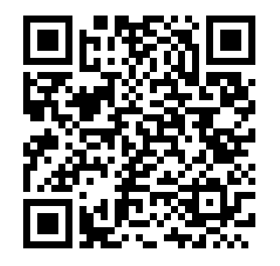

Icebreaker
Let’s start off with a short quiz game called ‘Do you know about AI’.
Scan the QR code with your phone, or use the link provided by your facilitator.

Slide 6





Meet the four platforms
Each tool has its strengths - by the end of today, you’ll know which to reach for and when.
1
2
3
4
Microsoft Copilot
ChatGPT
Claude
Perplexity
Productivity inside Word, Excel, Outlook & Teams.
Creative, flexible - great for everyday tasks.
Long-text specialist for research and reports.
Sourced answers with verifiable citations.

Slide 7

Microsoft Copilot

Slide 8

Microsoft Copilot overview
  Built into Microsoft 365 e.g. Word, Excel, Outlook, Teams.
  Helps with writing, summarising, planning and organising.
  Best for productivity and work-related tasks.

Slide 9
Getting into Copilot
WITH A MICROSOFT 365 ACCOUNT
NO ACCOUNT / PUBLIC PC
Full Copilot
Free Copilot in browser
  Go to office.com and sign in.
  Open Word, Excel, Outlook or Teams.
  Click the Copilot icon in the ribbon or sidebar.
  Type your prompt - e.g. 'create a project plan'.
  Open browser, or visit a search engine.
  Search for Microsoft Copilot and visit the website.
  Type your prompt and start using it.

Slide 10
Live walkthrough
Microsoft Copilot is best used for productivity tasks. Let’s try together:
EMAILS
DOCUMENTS
REWRITE
“Draft a friendly email
requesting a meeting update.”
“Analyse this document
and summarise the key points.”
“Rewrite this email to sound
more professional.”
PLAIN ENGLISH
SHOPPING LISTS
PLANNING
“Summarise this report
in plain English.”
“Create a weekly shopping list for two adults for 7 days.”
“Plan a low-cost 1-day outing in Adelaide for one person, including activities, lunch, and transport.”

Slide 11
ChatGPT

Slide 12
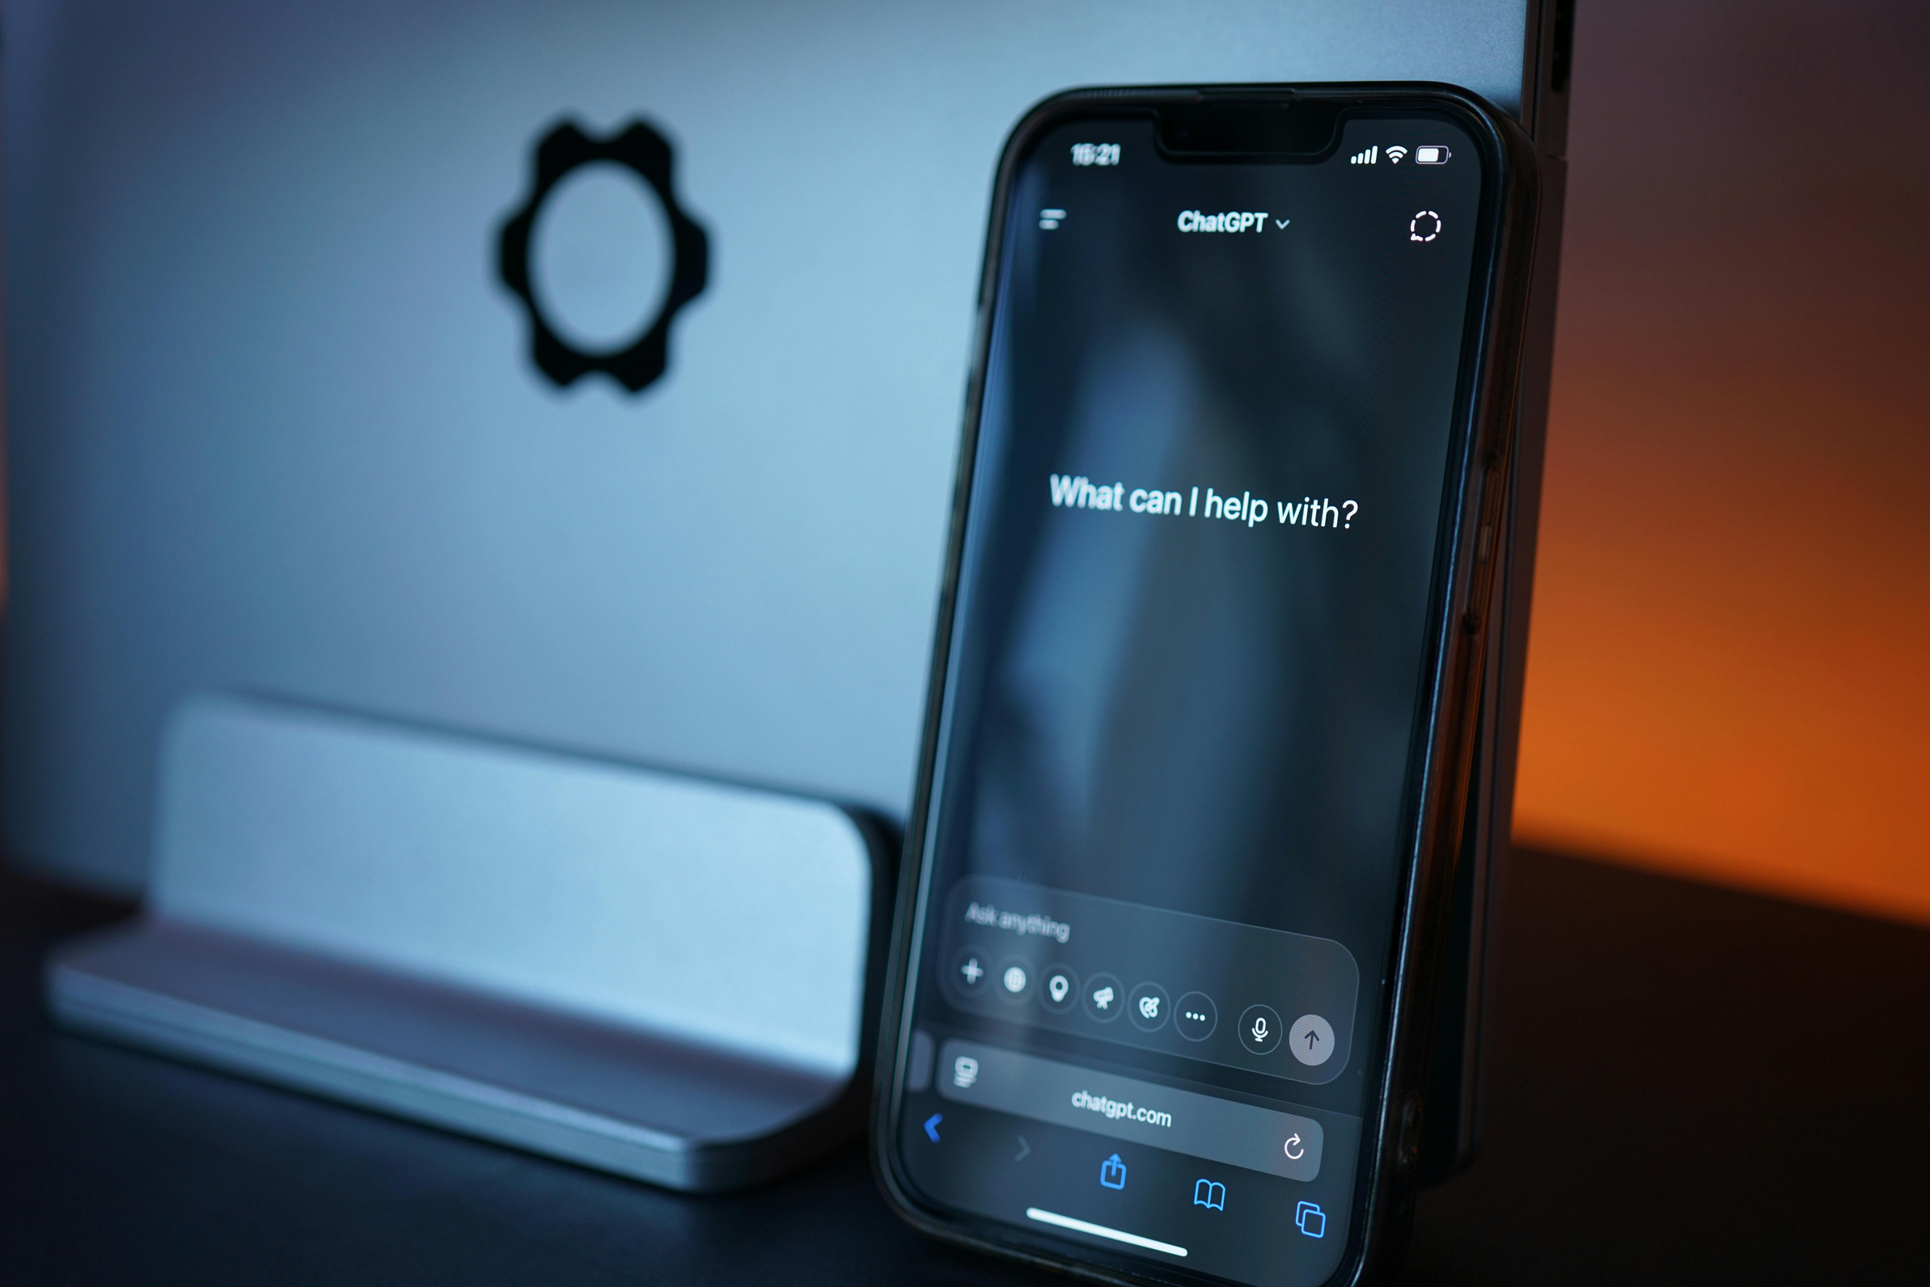
ChatGPT overview
  Answers questions, explains topics, generates ideas.
  Plain text — very versatile.
  Best for creative, casual and informal tasks.

Slide 13
Live walkthrough
ChatGPT is best used for creative and everyday things. Let’s try together:
PLANNING
TRANSLATION
EXPLAINING
“Help me create a weekly
to-do list for work and home.”
“Translate this paragraph
into Italian.”
“Explain recycling to a 10-year-old
vs. an adult.”
RECOMMENDATIONS
TRAVEL
GARDENING
“Suggest 5 mystery books
by Australian authors.”
“Plan a 3-day Melbourne
itinerary on a budget.”
“List the best vegetables to plant in autumn in South Australia.”

Slide 14

Break

Slide 15
Claude

Slide 16

Claude overview
  Excellent at summarising, analysing and reviewing long content.
  Ideal for research, reports and detailed instructions.
  Strong on accuracy and reasoning for complex tasks.

Slide 17
Live walkthrough
Claude is best used for long-text & research. Let’s try together:
SUMMARISE
REWRITE
SYNTHESISE
“Summarise this long report
into key bullet points.”
“Rewrite this report for senior
management in plain English.”
“Summarise these 5 articles
into a single one-page summary.”
RECOMMEND
ANALYSE
DRAFT
“Recommend 3 strategies to
improve library engagement.”
“Find the main themes in
this customer feedback.”
“Draft a 2-page proposal
from these notes.”

Slide 18
Perplexity

Slide 19

Perplexity overview
  Answers questions with sourced results.
  Great for fact-checking and research-heavy tasks.
  Provides citations and references you can verify.

Slide 20
Live walkthrough
Perplexity is best used for sourcing answers. Let’s try together:
RESEARCH
SUMMARISE
TRANSLATE
“Explain the history of public
libraries in South Australia.”
“Summarise this research
article in 5 sentences.”
“Explain this in plain English
for a local newsletter.”
RECOMMEND
TRAVEL
VERIFY
“Recommend 3 books on AI in
libraries — include year and author.”
“Suggest 3 budget-friendly
February destinations in Australia.”
“Fact-check this claim
and cite your sources.”

Slide 21
Compare, safety and Q&A

Slide 22
Which one should you use?
STRENGTH
STRENGTH
STRENGTH
STRENGTH
Productivity in
Microsoft apps
Creative &
flexible
Long text &
summaries
Sourced
answers
BEST FOR
BEST FOR
BEST FOR
BEST FOR
Work tasks, emails,
reports
Ideas, casual prompts,
language
Research,
documents
Fact-checking,
research

Slide 23
Safe and smart AI use
Safe & smart use
Privacy & policies
  Use AI to enhance — not replace — human judgement.
  AI helps, but always double-check facts.
  Avoid sharing personal or sensitive data.
  Be specific in your prompts to get better answers.
  Prompts may be stored or reviewed by providers.
  Follow your workplace's AI policy and guidance.
  Australian Government AI Ethics Principles apply.
  When in doubt — ask before you upload it.

Slide 24

Why AI literacy matters
AI & digital literacy
DIGITAL LITERACY
Being digital - Everyday tech, practical skills.
  Understanding the limits of AI tools.
  Asking better, clearer questions.
  Checking and verifying outputs.
  Making informed everyday decisions.
eSAFETY
Online protection, privacy, safe browsing.
PUBLIC LIBRARIES
Community hub, knowledge, lifelong learning.
EDUCATION
TAFE - Skills development, practical learning.

Slide 25


Do you have any questions?

Slide 26


Thank you.

