Slide 1

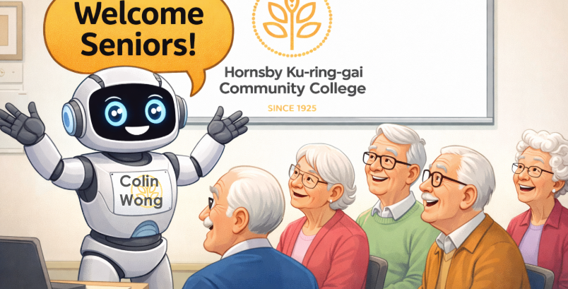



Introduction
to Artificial Intelligence (AI)

Slide 2


Acknowledgement of Country
We acknowledge the traditional custodians of the land and pay our respect to Elders past and present and extend that respect to Aboriginal and Torres Strait Islander peoples joining us today.
Image credit: Urtakerte/Heart indigemoji
Artist: Dreamtime Ladie by Kathleen Kemarre Wallace with Graham Wilfred
Download Indigenous emojis at www.indigemoji.com.au

Slide 3

Agenda
In today‘s session, we will be covering:
  Introduction
  What is AI?
  Example scenario
  AI chatbots
  AI safety

Slide 4

Introduction

Slide 5


Icebreaker
Introduce yourself and share:
  Your name
  What your expectations for today’s session are
  If you been using or have been affected by AI.

Slide 6



Important notes
We are not AI experts - we are just here to help however we can.
You may have more questions at the end, and that is ok.
At the end, you may be more optimistic, pessimistic, or both - that is ok as well.

Slide 7
What is AI?

Slide 8

What is AI?
So what do you think AI stands for? Does it mean:
  Awfully Inexplicable?
  Always Informative?
  All-round Infiltration?
  Almost Immortal?

Slide 9
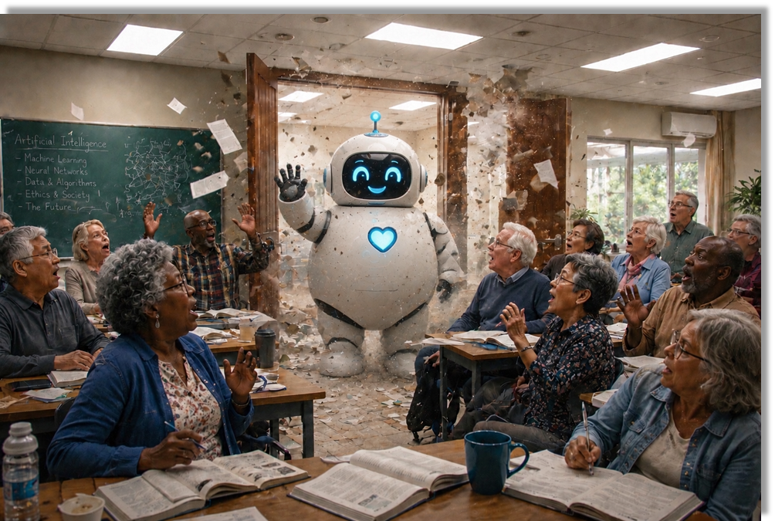
What is AI?
AI stands for Artificial intelligence.
It is a type of computer technology used to build software and systems that can think, learn, and problem-solve, just like a human.

Slide 10
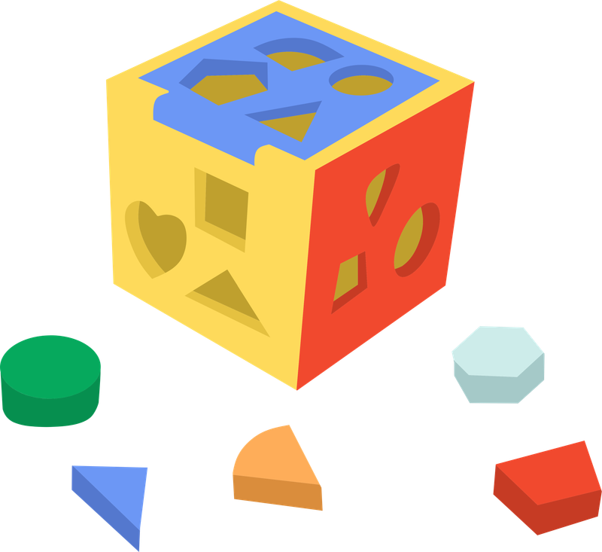

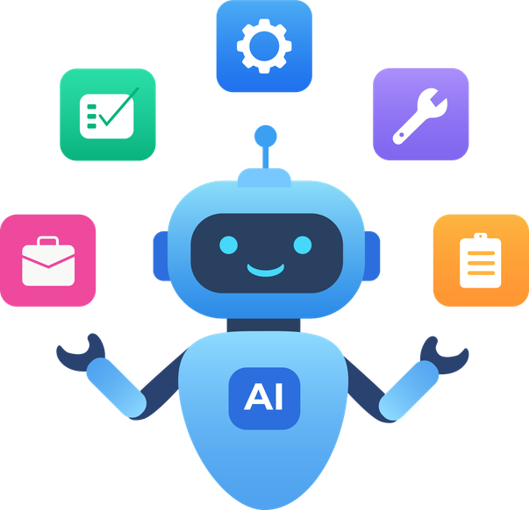

What is AI?
AI learns from experience, like recognising patterns, images or languages.
AI can help you problem solve or make decisions.
AI can produce for your, like helping you write, creating images, or even audio and videos.
AI can also remember things and take actions for you automatically.

Slide 11

What is AI?
Let’s take a look at tasks performed by AI that affect us now.

Slide 12

What is AI?
Let’s discuss:
Do you think you can live without getting involved with AI?

Slide 13
Example scenario

Slide 14
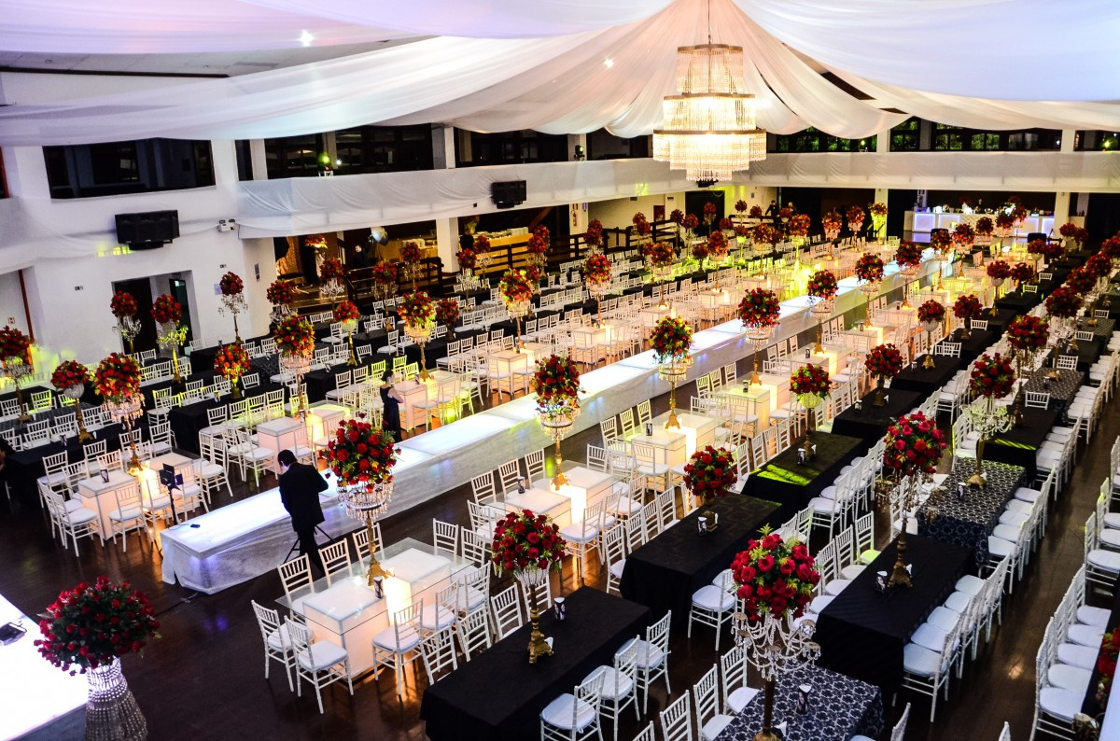
Example scenario
Let’s use an example to explain the role of AI:
You have to organise a wedding reception for your good friend. Where do you start?

Slide 15

Strategy 1
You can plan all details yourself by gathering and using your past experience of venues, food, decorations, etc. and do it yourself.

Slide 16

Strategy 2
Get advice from different resource providers regarding all the details then plan and do it yourself with friends.

Slide 17

Strategy 3
Get a consultant to provide you with a complete plan including schedule, cost, description, etc. Then organise and supervise it yourself.

Slide 18

Strategy 4
Get a project manager to organise and implement the whole event for you under your supervision.

Slide 19
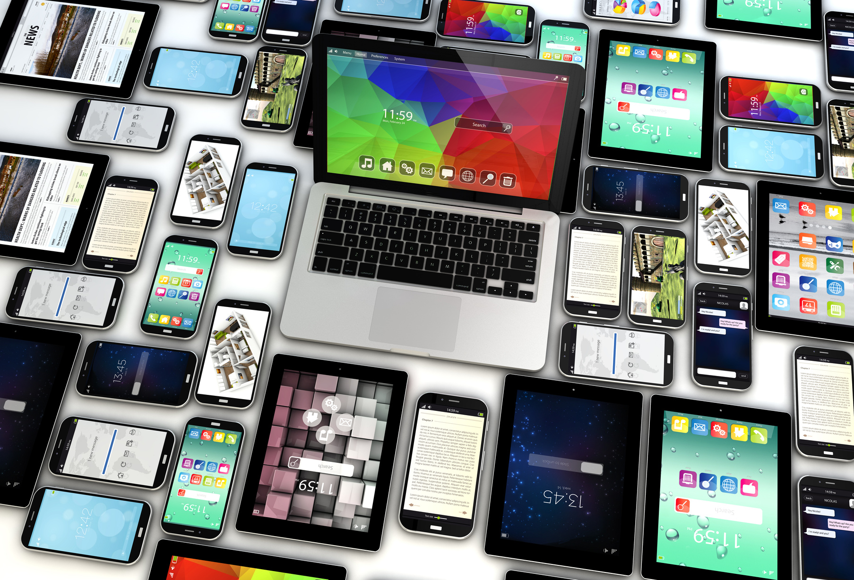
Strategy review
Although not immediately evident, each of these strategies include some kind of use of technology and/or AI.
Let’s take a look at how it appears in each scenario.

Slide 20
Strategy review
Strategy | Human approach | Use of technology
1 | Use one’s past experience | Refers to past notes, documents and pictures in computers
2 | Ask around (friends, advertisements) | Search Engine such as Google
3 | Talk to consultants | AI Chatbots such as ChatGPT, Gemini, Deepseek, etc
4 | Get a project manager and monitor | AI Agents, use of AI robots

Slide 21

Use of technology and AI is everywhere - it is important to understand it so you can stay safe.

Slide 22
AI chatbots

Slide 23
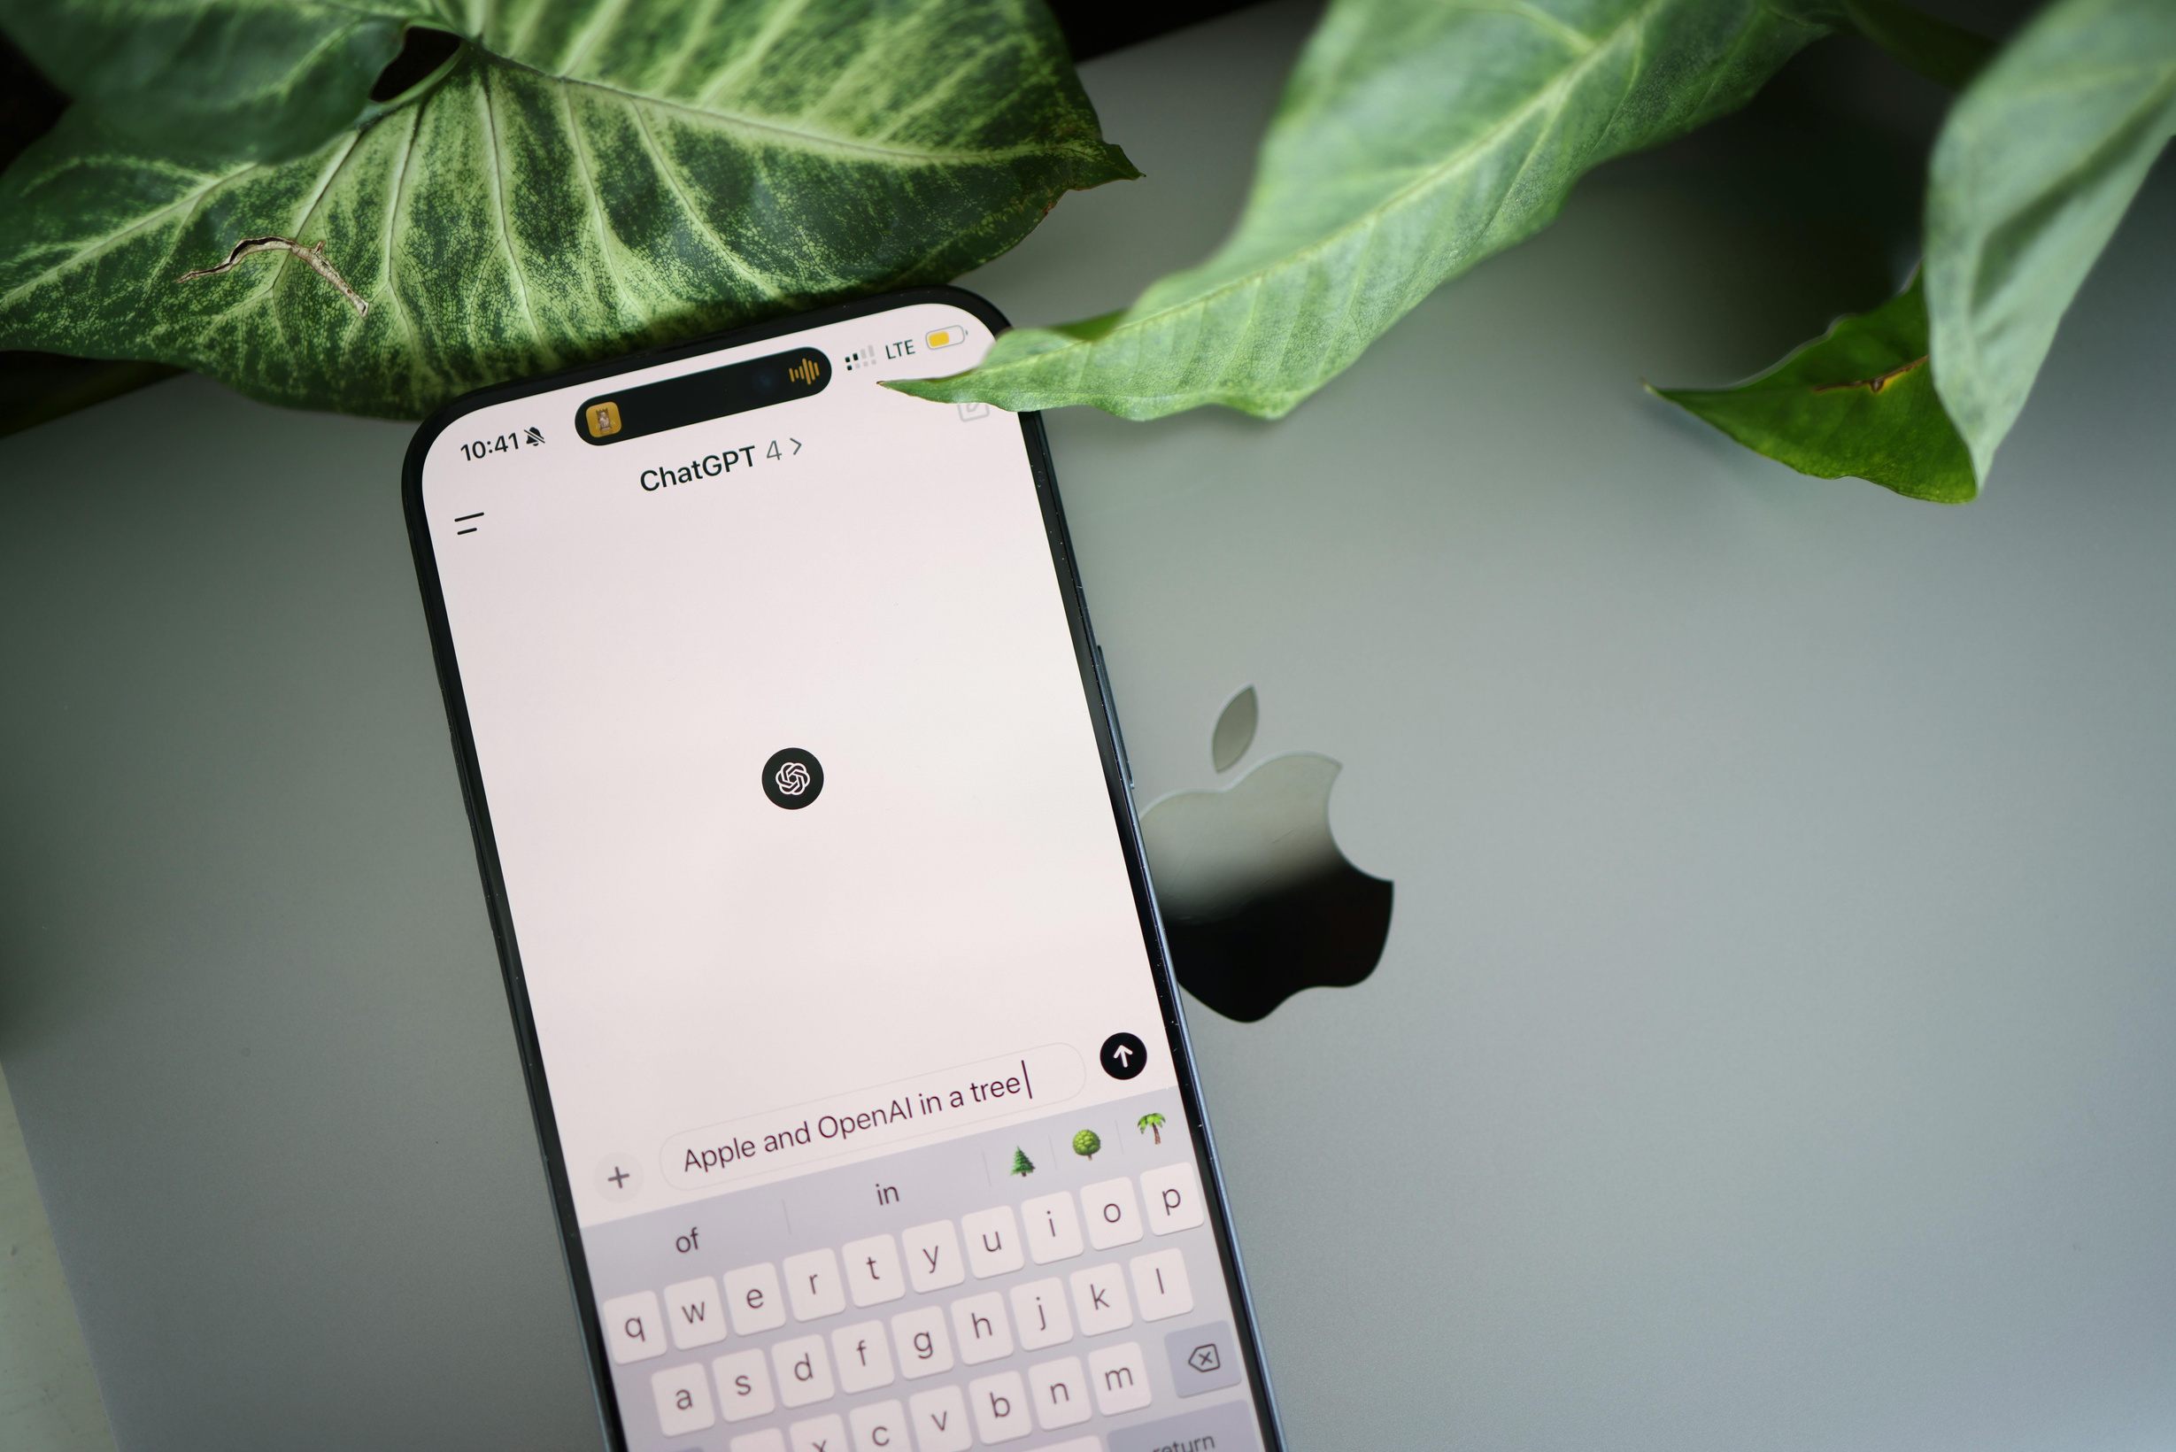
What is an AI chatbot?
An AI chatbot is a computer program you can talk to. You simply type your questions and the chatbot types back with an answer.

Slide 24

Well-known AI chatbots
Some of the more common AI chatbots that you might know are:
  ChatGPT
  Gemini
  Claude AI
  Microsoft Copilot.

Slide 25


Activity
Let’s practice using AI chatbots together as a group and discuss our findings.

Slide 26
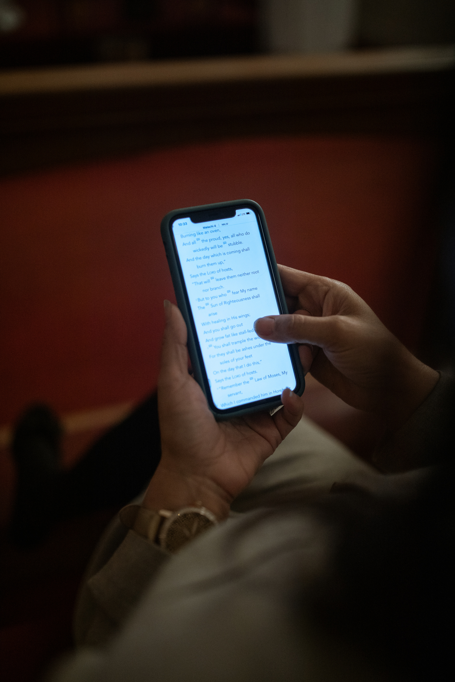
Activity
Open ChatGPT on your mobile devices or computer, and give the following instruction or prompt:
“Please plan a wedding reception for me”.
Submit it. See what it comes back with.

Slide 27

Activity
What do you think about the response that the AI chatbot gave you?

Slide 28
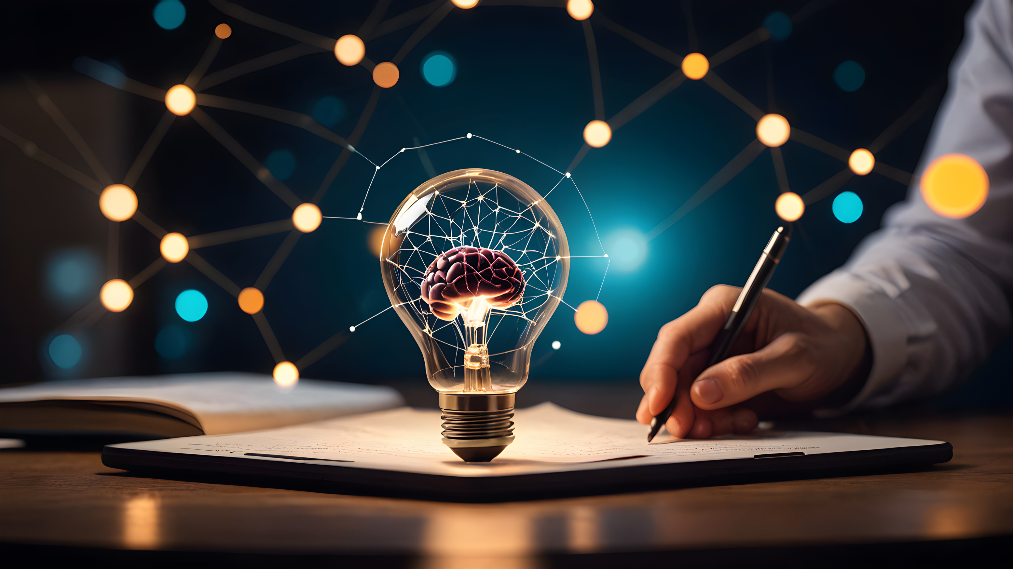
Activity
AI chatbots can also help you create images.
Let’s use ChatGPT to help us create images by providing a text description.

Slide 29

Activity
  Use the text to image feature in ChatGPT.
  Describe a picture that you want it to create for you.
  See what it comes back with.

Slide 30
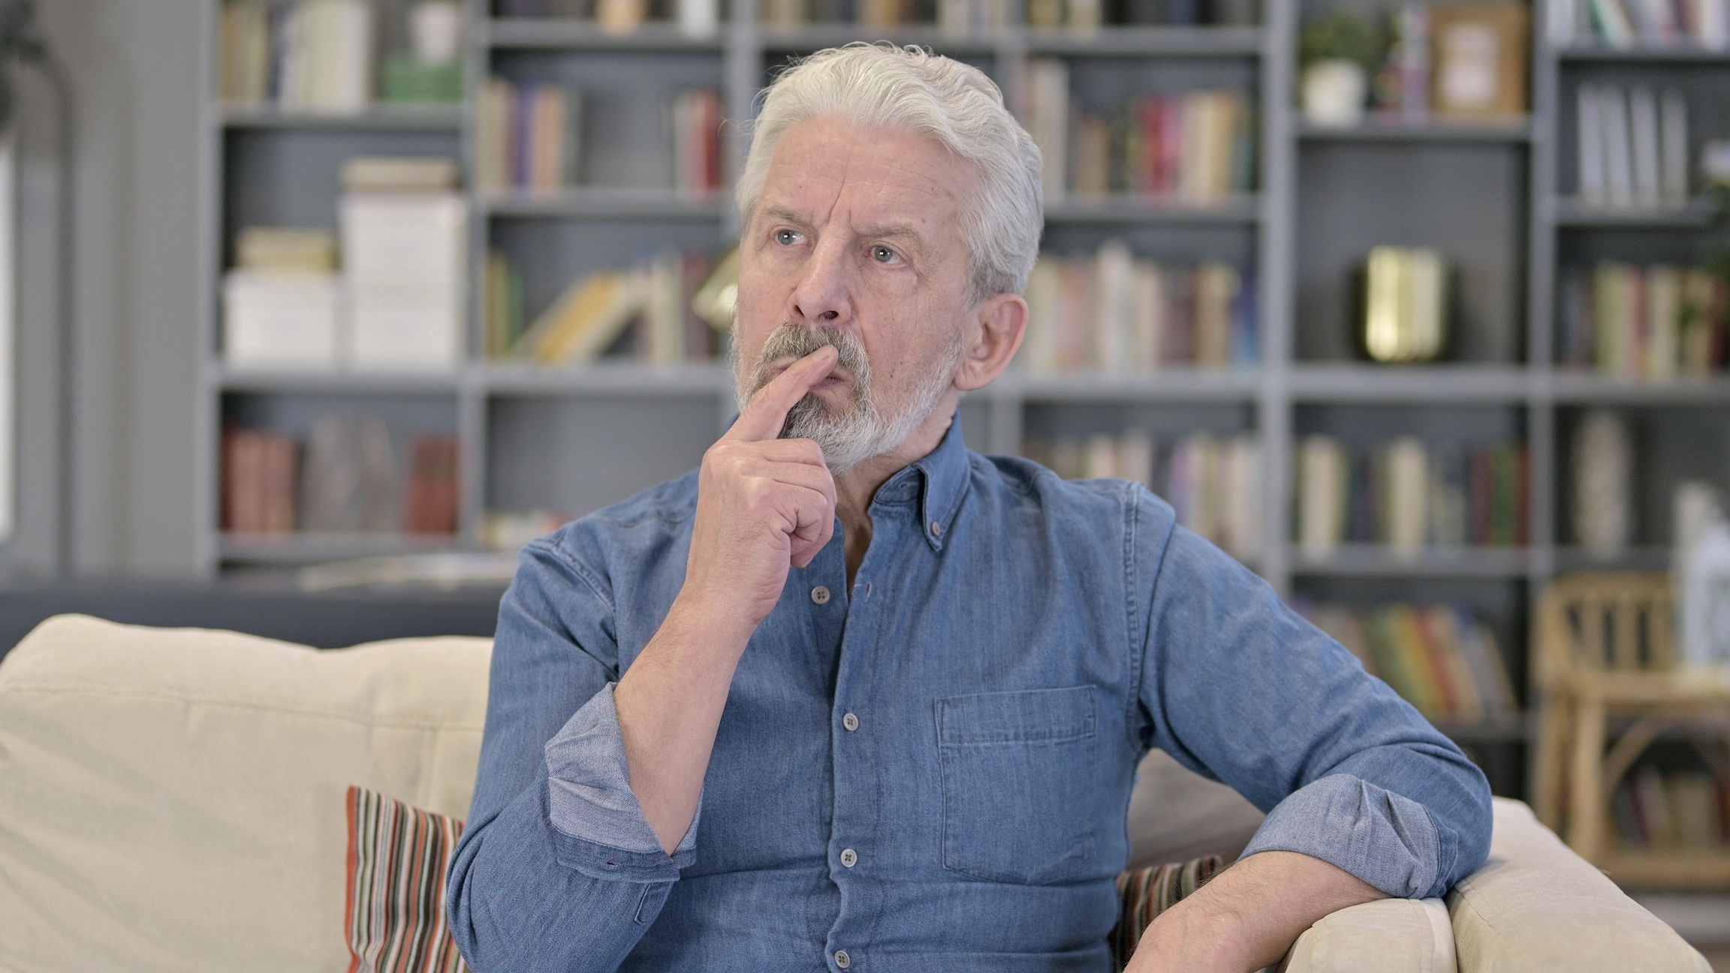
Activity
What do you think about the image that was created for you?

Slide 31
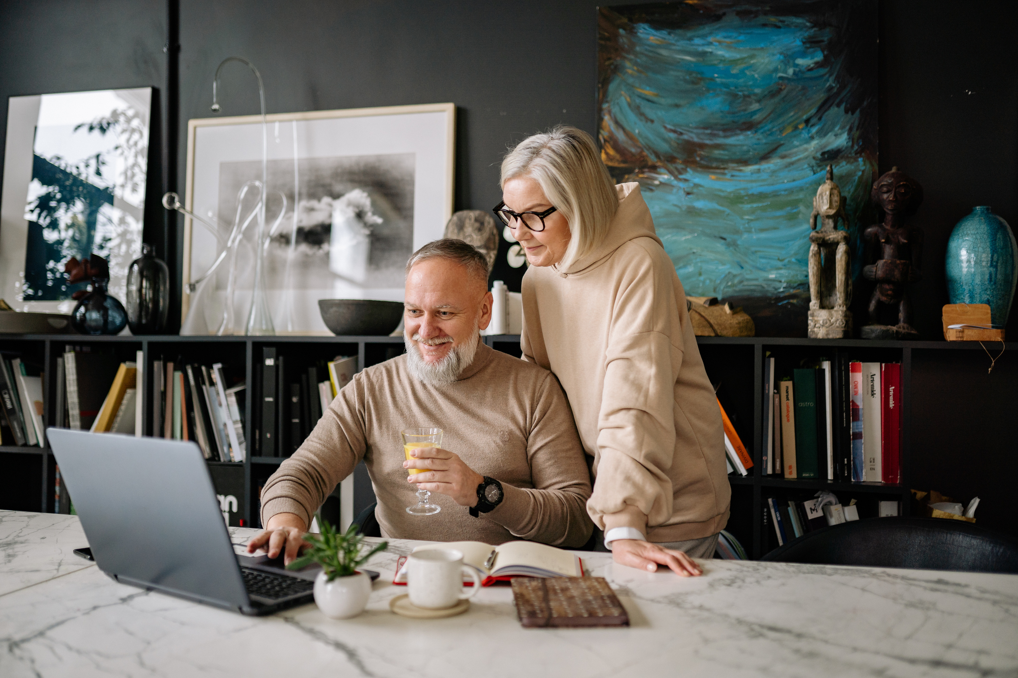
AI chatbots can do a lot more, like make videos. Have fun exploring!

Slide 32
AI safety

Slide 33

What are the dangers of AI?
Some dangers of AI include:
  False information
  Fake images and videos
  Scams.
Visit the eSafety website for more information on how to stay safe.

Slide 34
How to stay safe
To help you get started, this is how you can help children (or even adults) use AI safely.

Slide 35

Do you have any questions?

Slide 36


Thank you.

