Slide 1
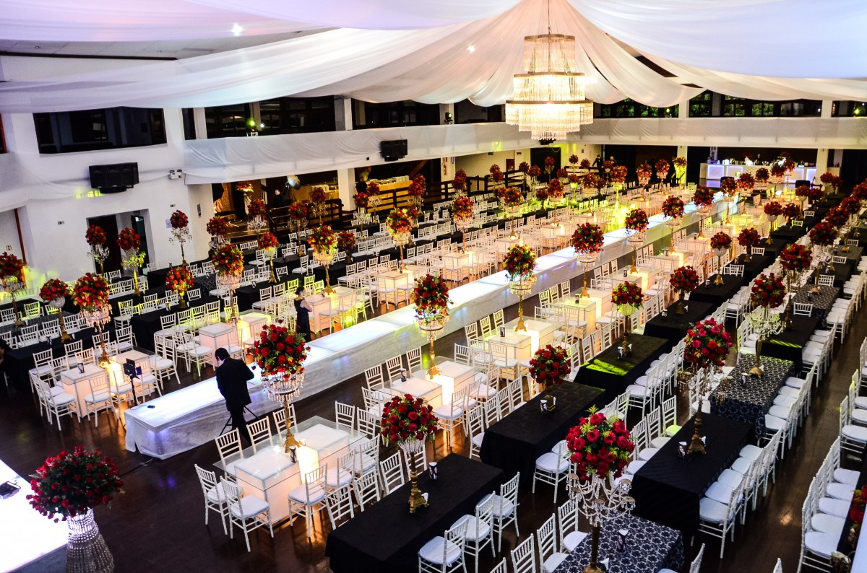


Example scenario
Let’s use an example to explain the role of AI:
You have to organise a wedding reception for your good friend. Where do you start?

Slide 2

Strategy 1
You can plan all details yourself by gathering and using your past experience of venues, food, decorations, etc. and do it yourself.

Slide 3

Strategy 2
Get advice from different resource providers regarding all the details then plan and do it yourself with friends.

Slide 4

Strategy 3
Get a consultant to provide you with a complete plan including schedule, cost, description, etc. Then organise and supervise it yourself.

Slide 5

Strategy 4
Get a project manager to organise and implement the whole event for you under your supervision.

Slide 6

Strategy review
Although not immediately evident, each of these strategies include some kind of use of technology and/or AI.
Let’s take a look at how it appears in each scenario.

Slide 7
Strategy review
Strategy | Human approach | Use of technology
1 | Use one’s past experience | Refers to past notes, documents and pictures in computers
2 | Ask around (friends, advertisements) | Search Engine such as Google
3 | Talk to consultants | AI Chatbots such as ChatGPT, Gemini, Deepseek, etc
4 | Get a project manager and monitor | AI Agents, use of AI robots

Slide 8
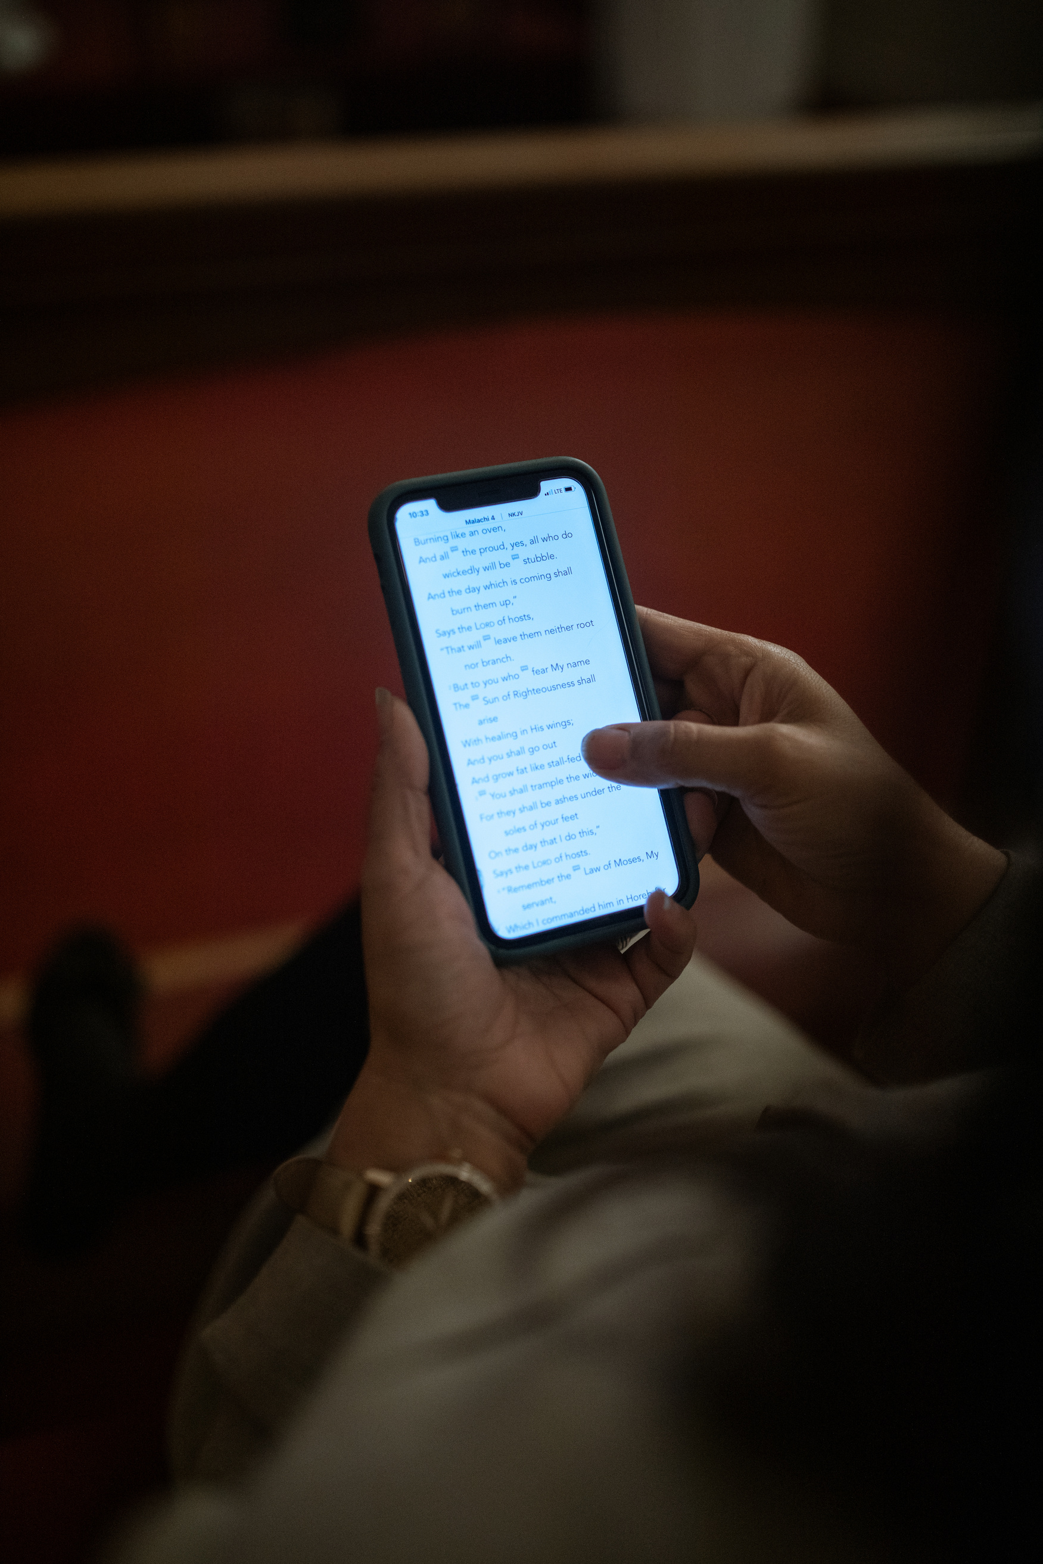

Activity
Open ChatGPT on your mobile devices or computer, and give the following instruction or prompt:
“Please plan a wedding reception for me”.
Submit it. See what it comes back with.

